Slide 1
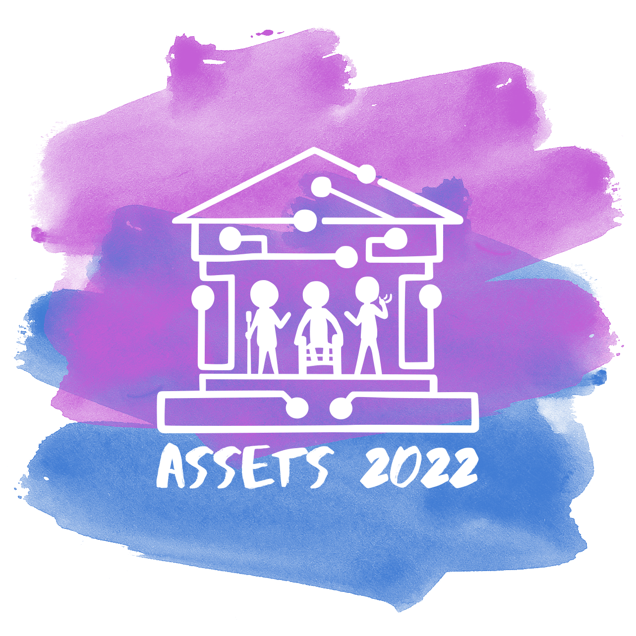


ASSETS 2022 Title Slide
The 24th International ACM SIGACCESS Conference on Computers and Accessibility
Athens, Greece
Oct 23-26

Slide 2
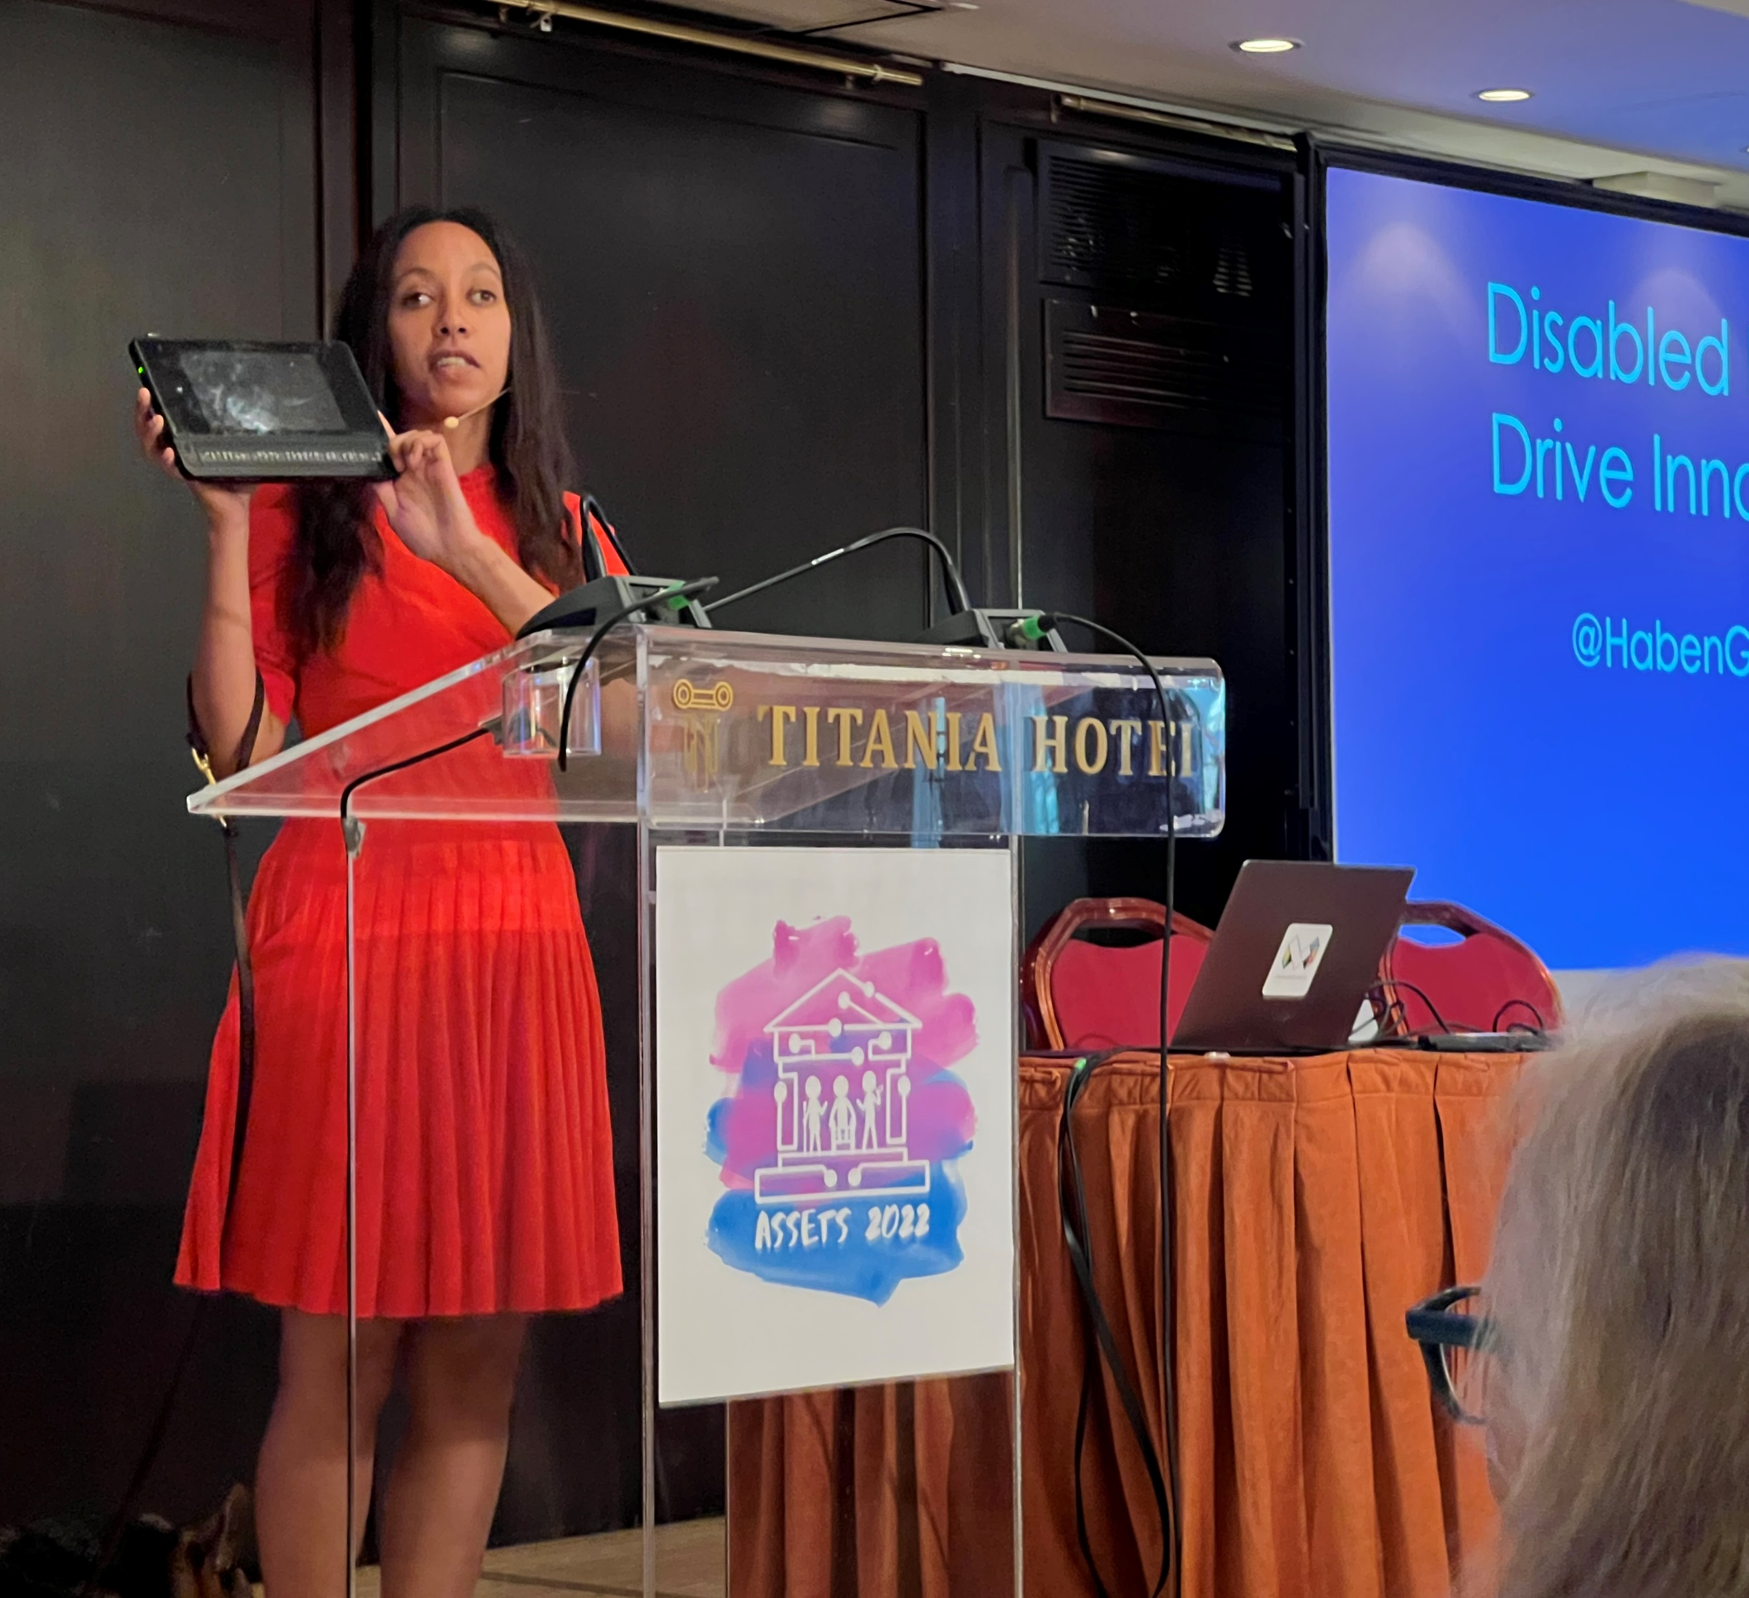
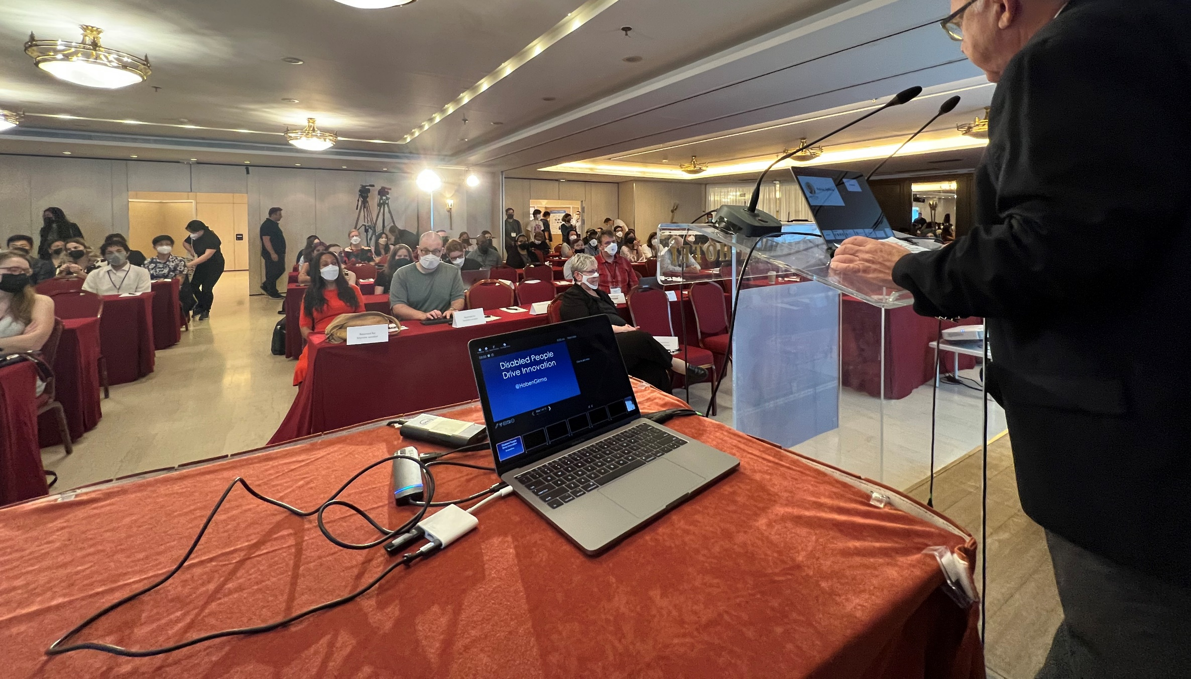
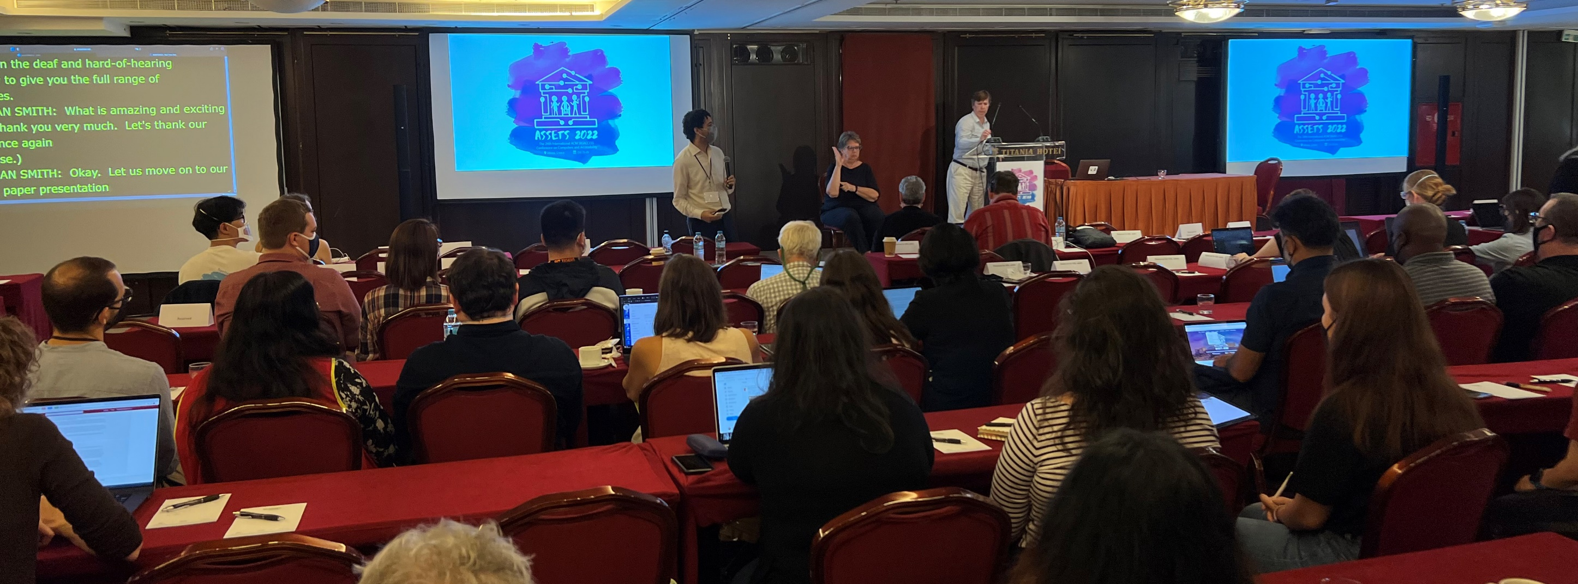
ASSETS’22 Day 1
Athens, Greece

Slide 3
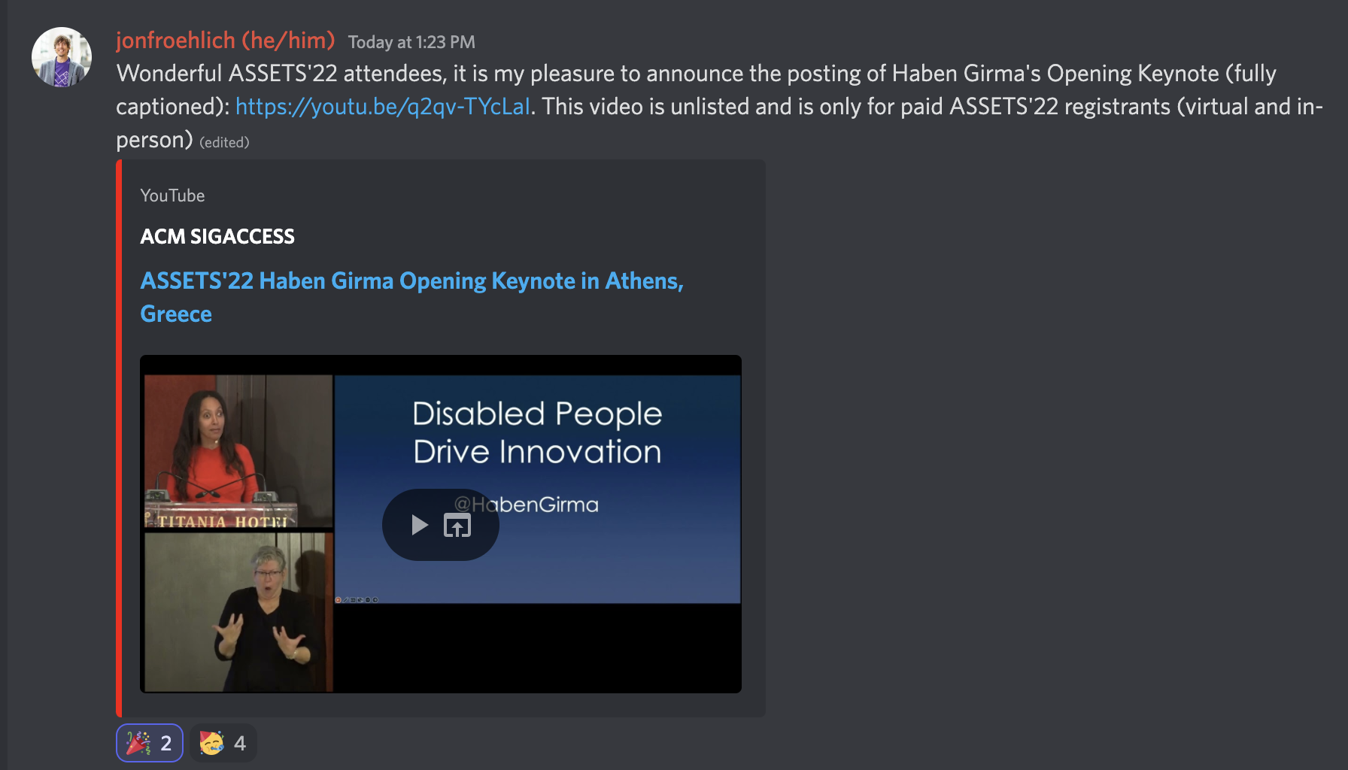
ASSETS’22 Day 1 View Keynotes on YouTube

Slide 4
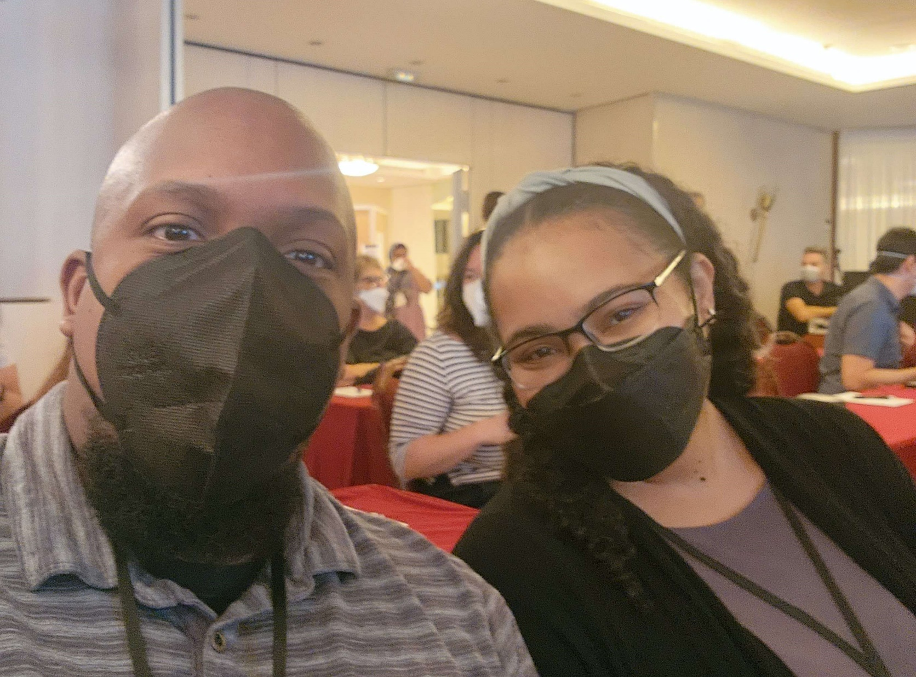
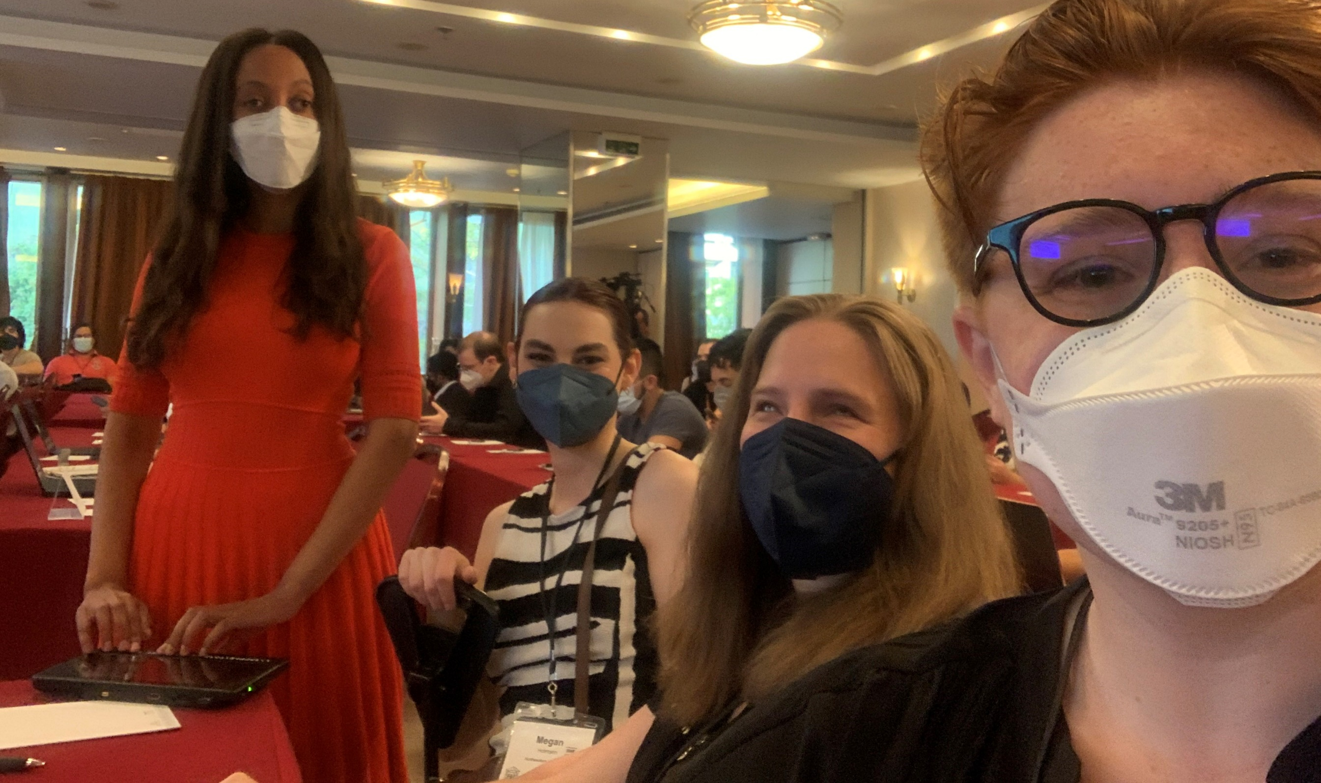
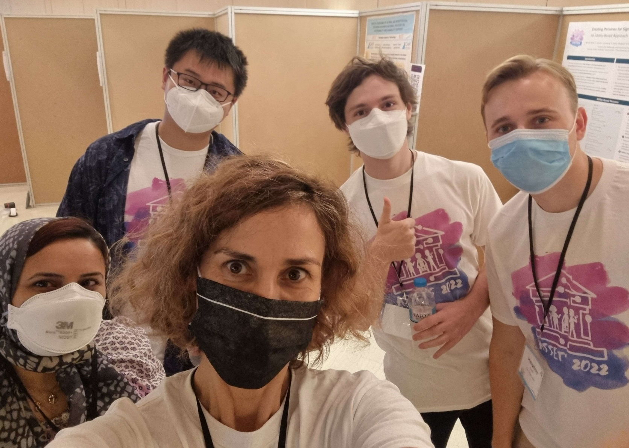
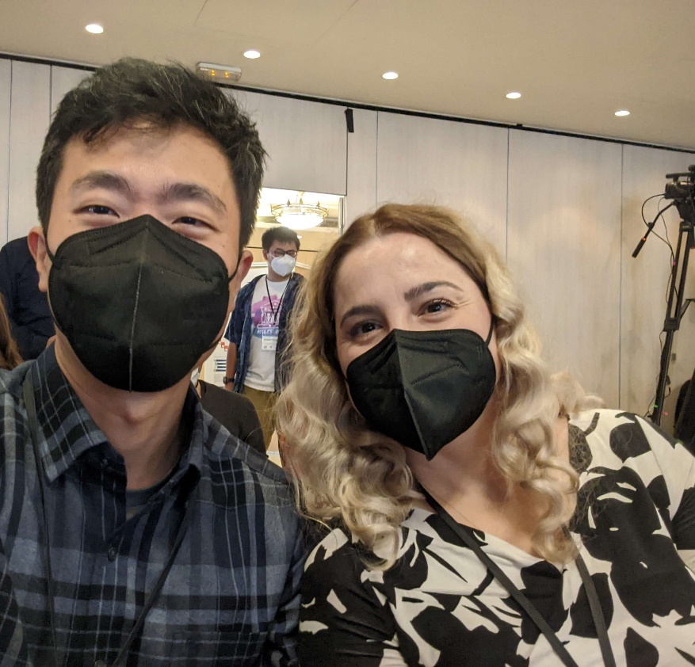
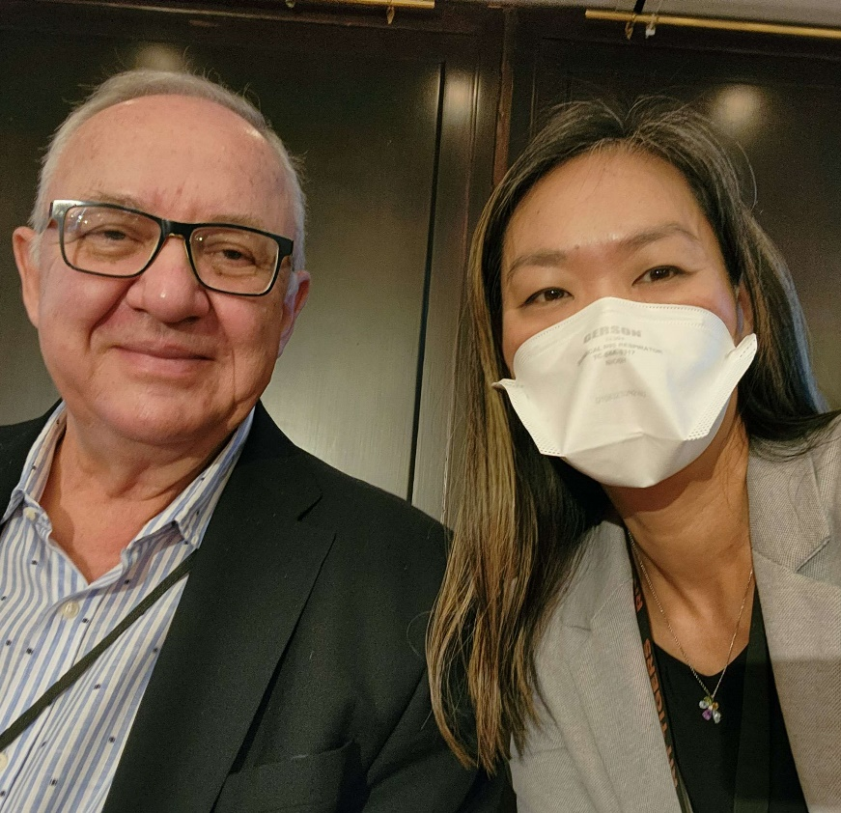
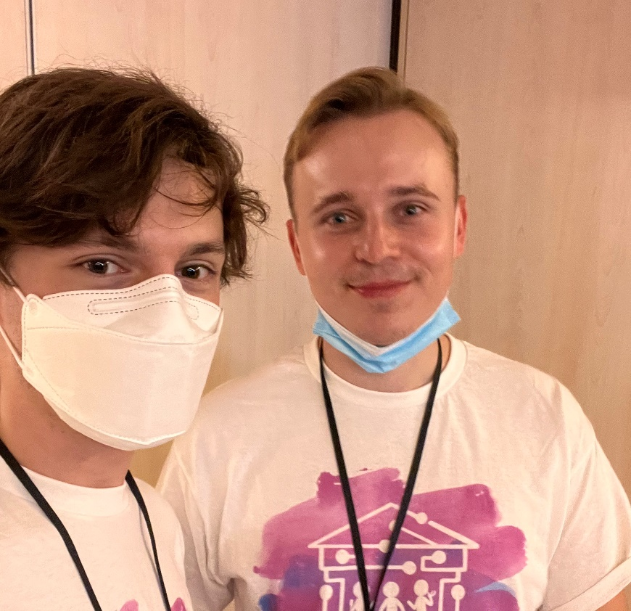
ASSETS’22 Day 1 Posters and Demos
ASSETS’22 Day 1
Posters & Demos
Notes:
And Discord was totally alive yesterday. Let’s keep it up!

Slide 5
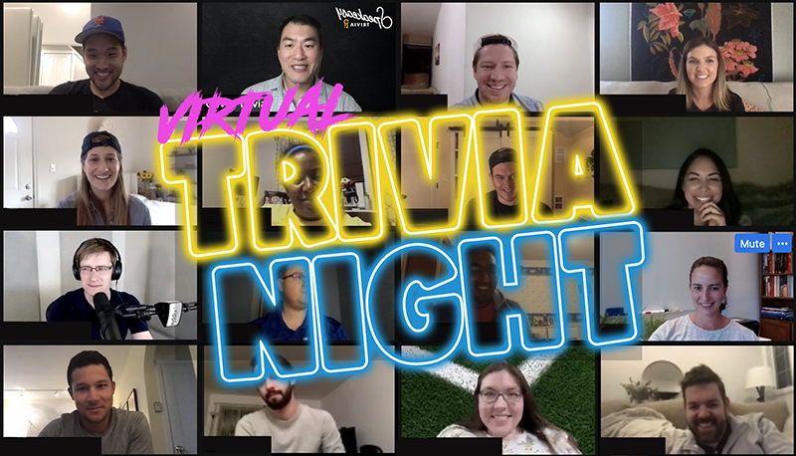
ASSETS’22 Day 1 Virtual Trivia
ASSETS’22 Day 1
Virtual Land

Slide 6
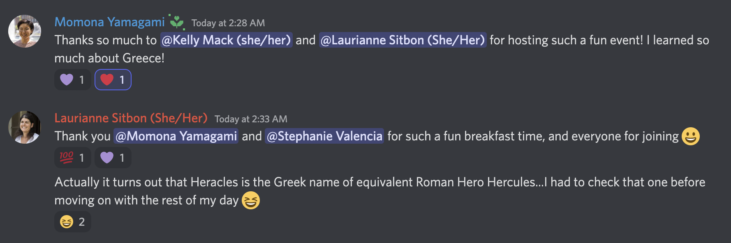
ASSETS’22 Day 1 Virtual Trivia Discord
Notes:
Here’s a screenshot from the Discord channel with Momona Yamagami saying … ”Thanks so much…”

Slide 7
Day 2 Summary
Notes:
We have a similarly exciting program for Day 2

Slide 8
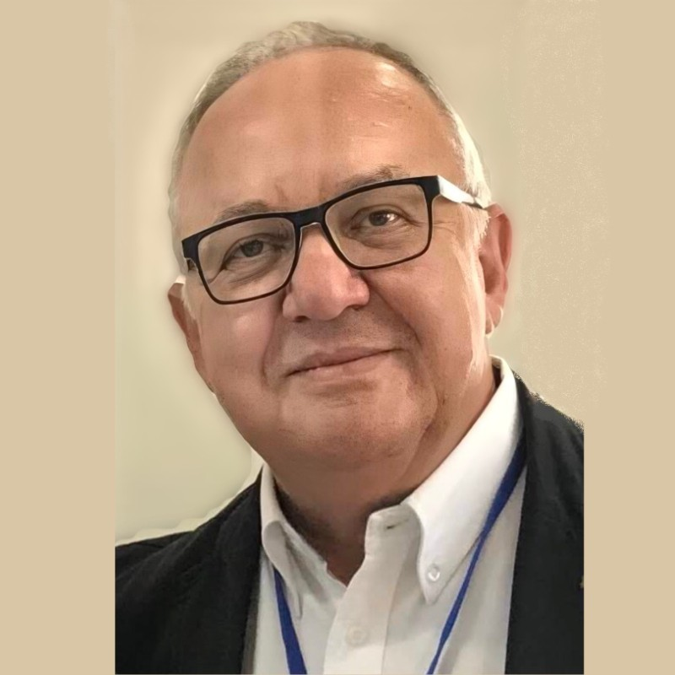
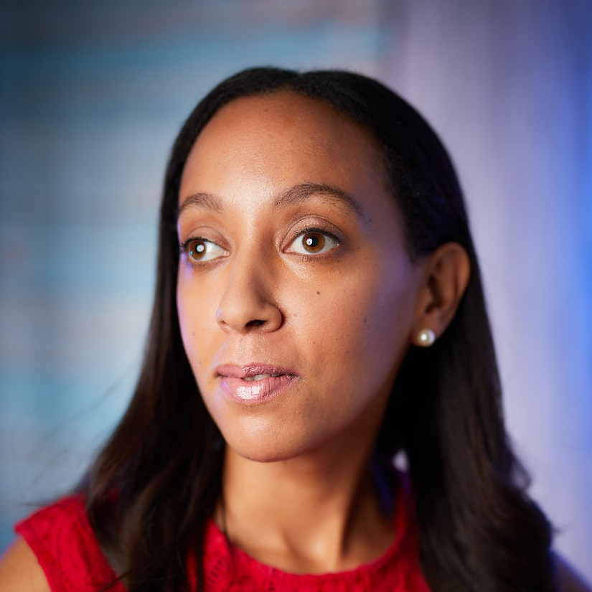
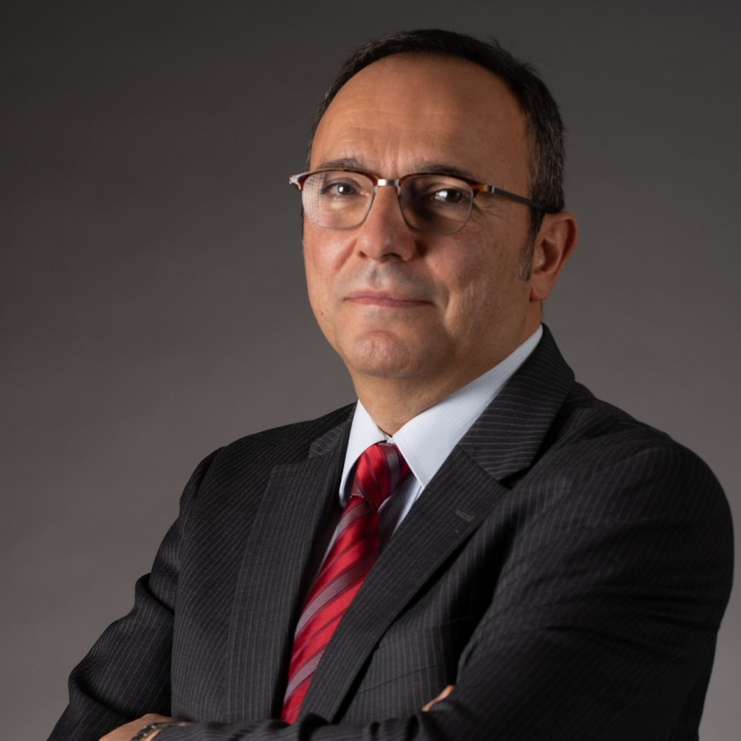
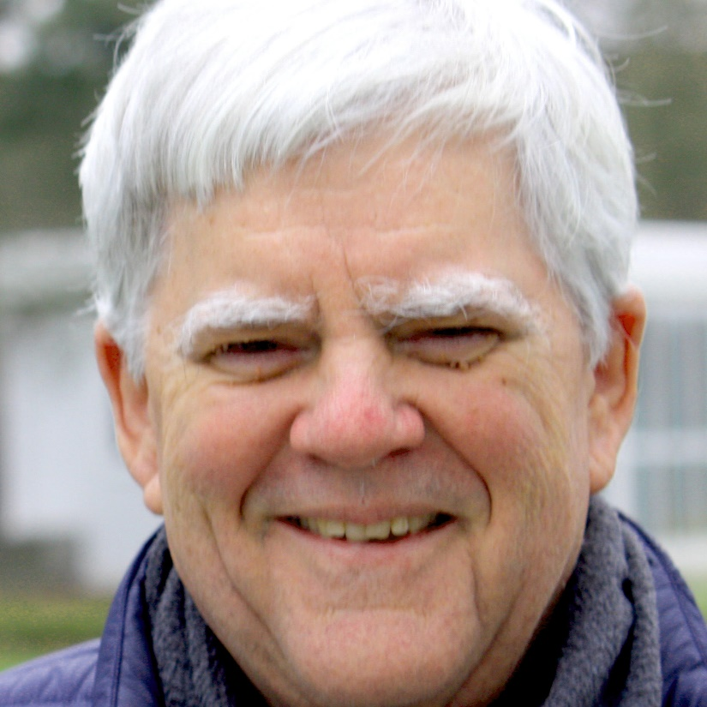
Distinguished Guests
Schedule
Monday
Tuesday
Georgios Kouroupetroglou President, Advancement of Assistive Technology in Europe; Prof, NKUA
Haben Girma
Human rights lawyer advancing disability justice
Yannis Ioannidis President, ACM Professor, NKUA
Clayton Lewis Professor Emeritus, U. of Colorado SIGACCESS Outstanding Contribution
Notes:
Today begins with two distinguished guests: ACM President Yannis EE-O-A-Nee-Dis and SIGACCESS Outstanding Contribution Awardee Clayton Lewis

Slide 9
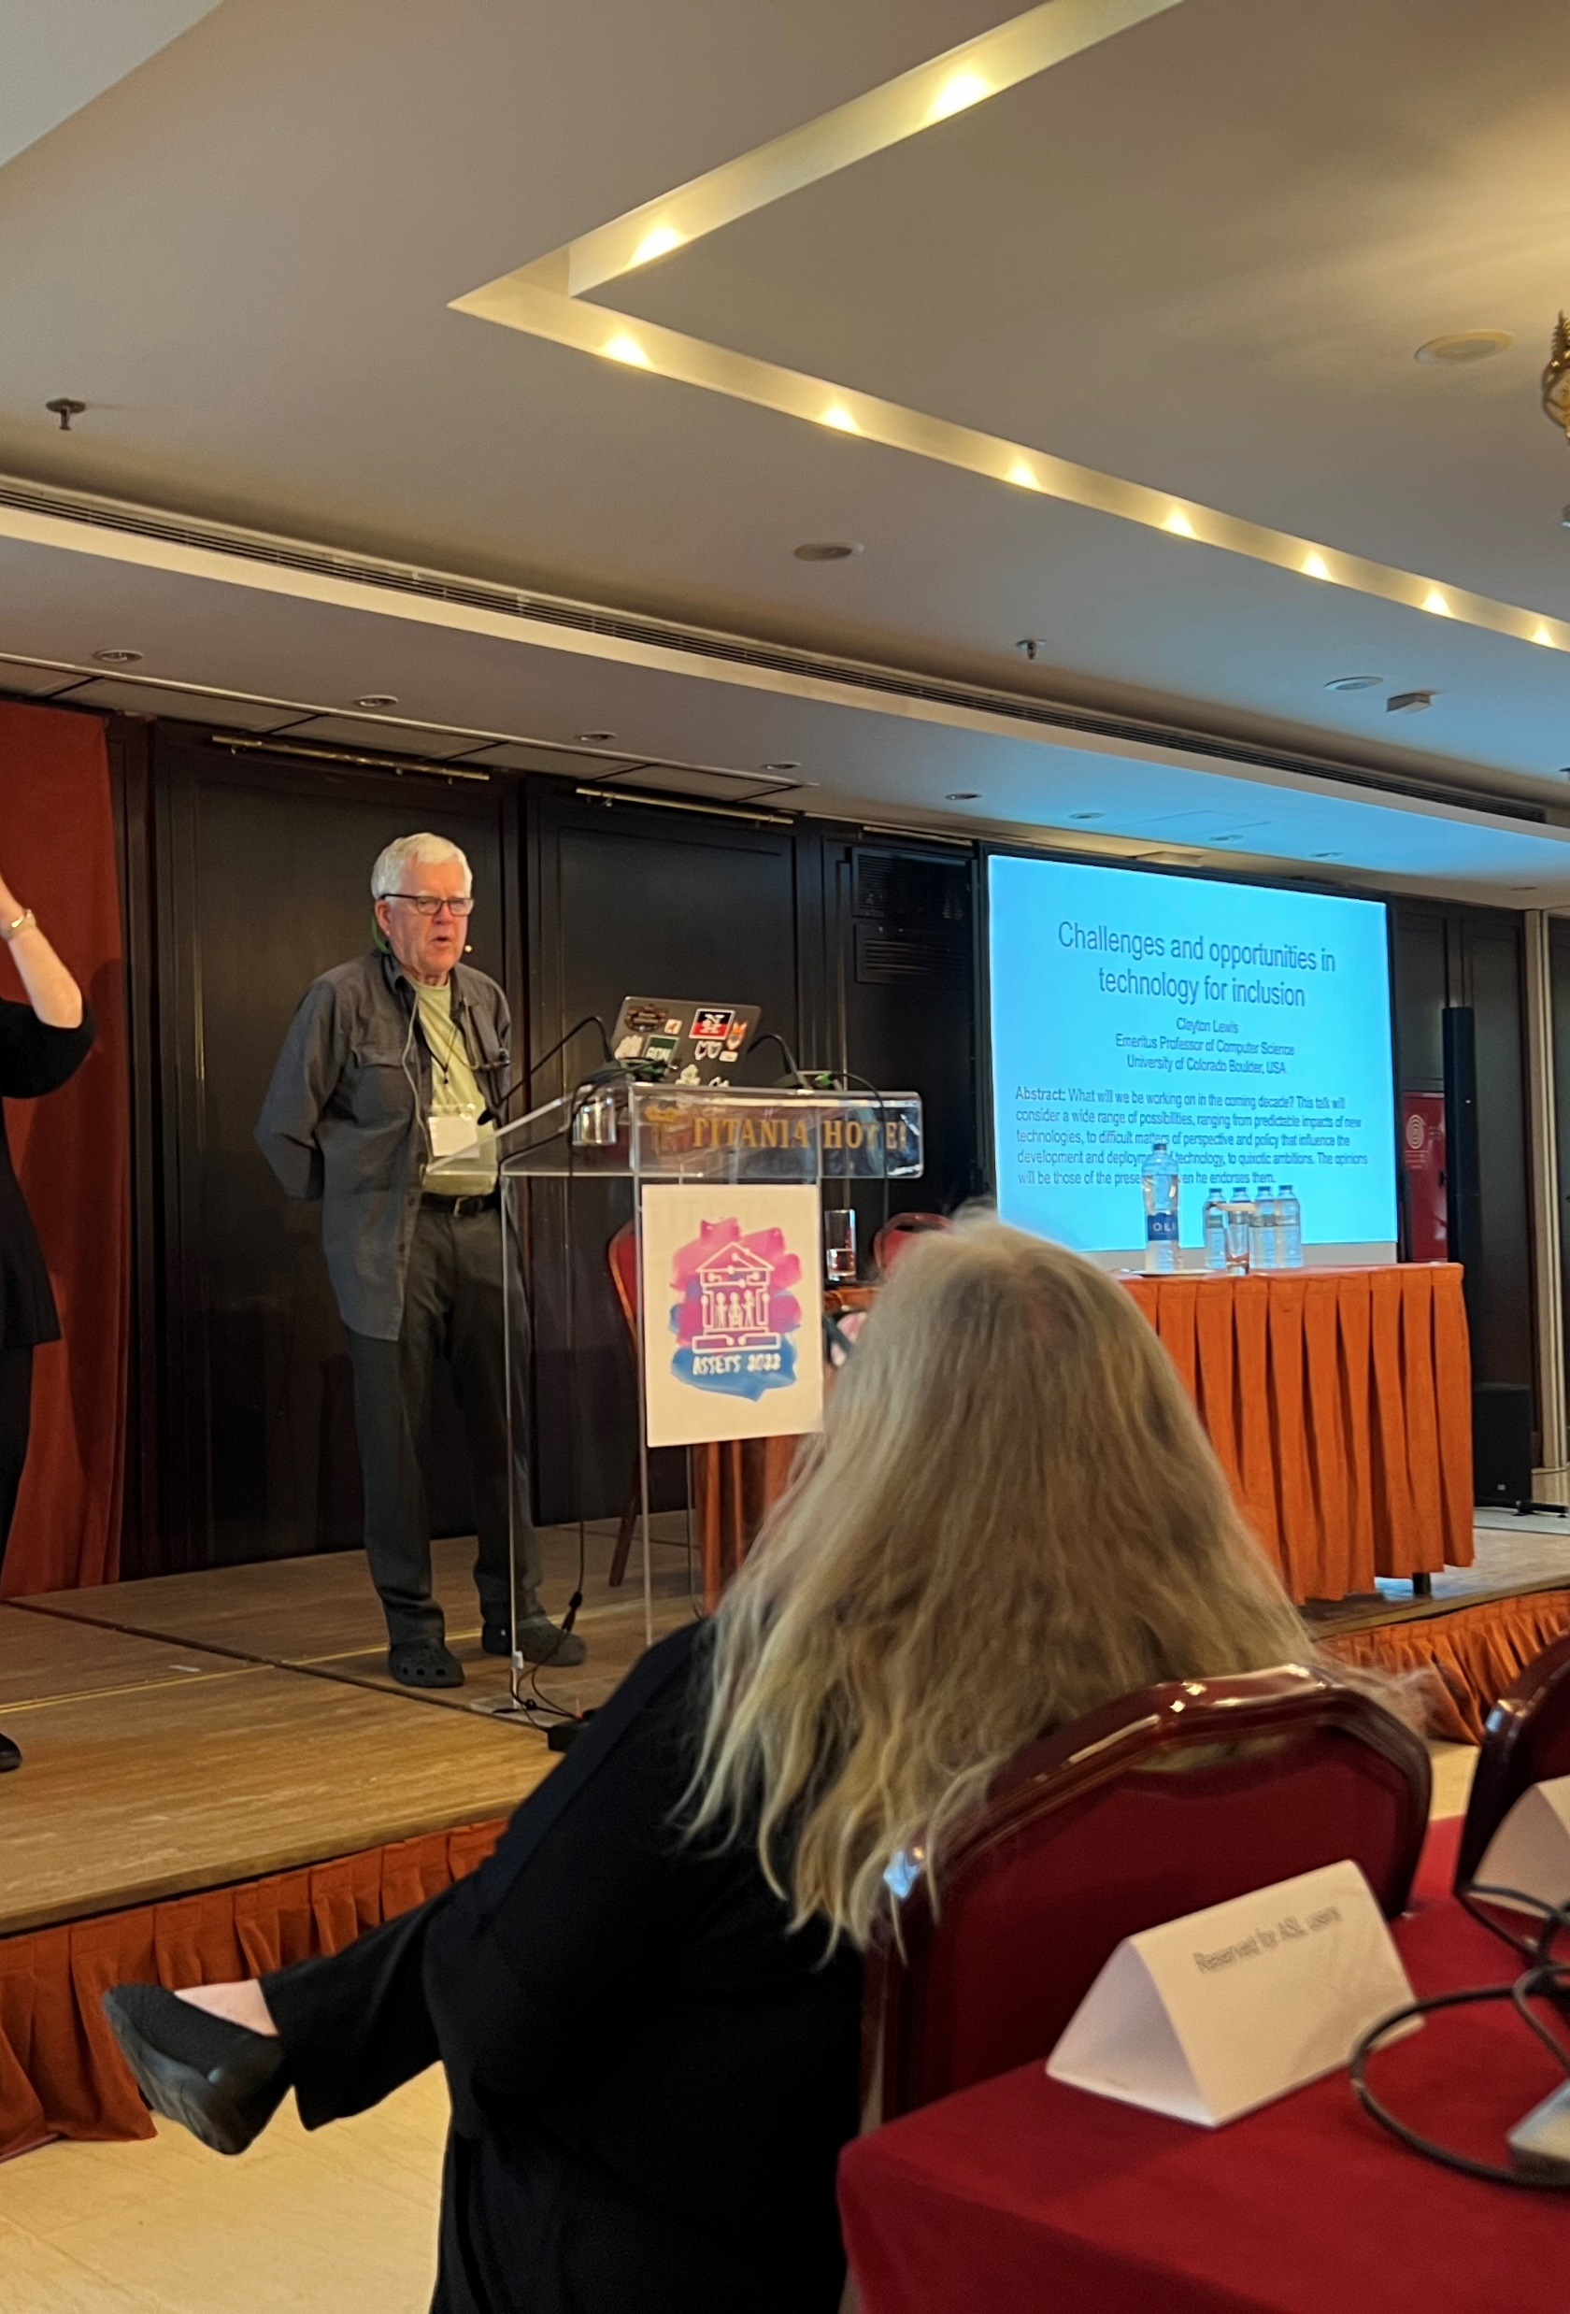
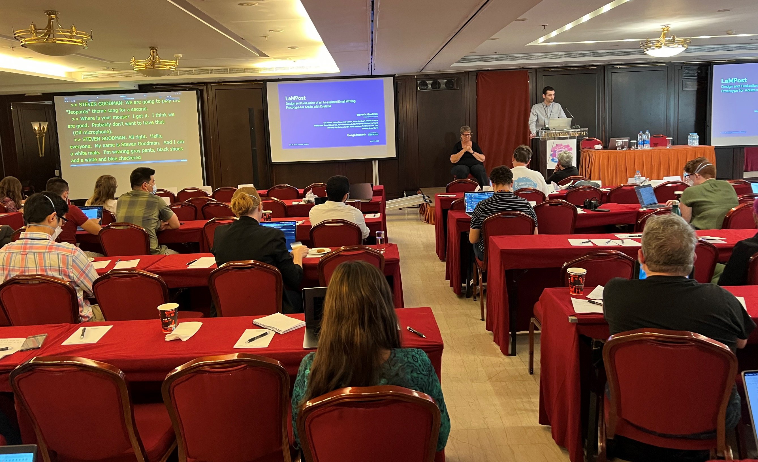
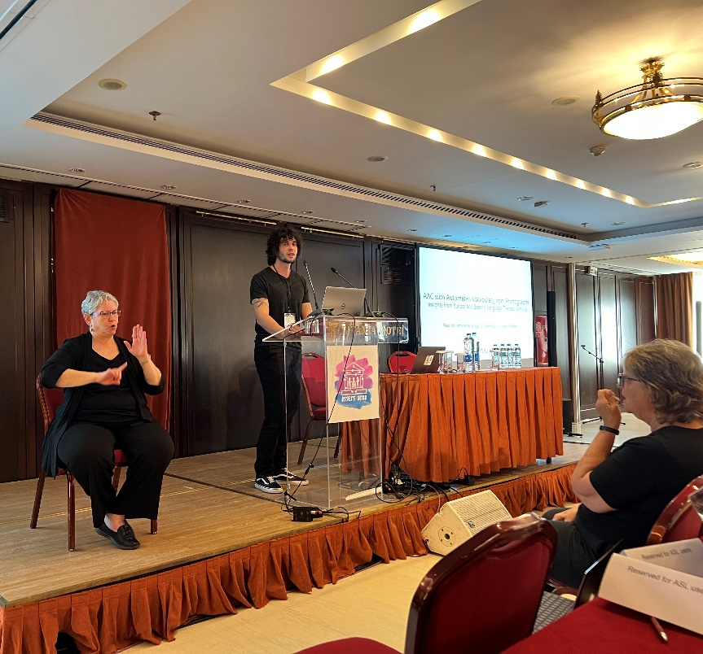
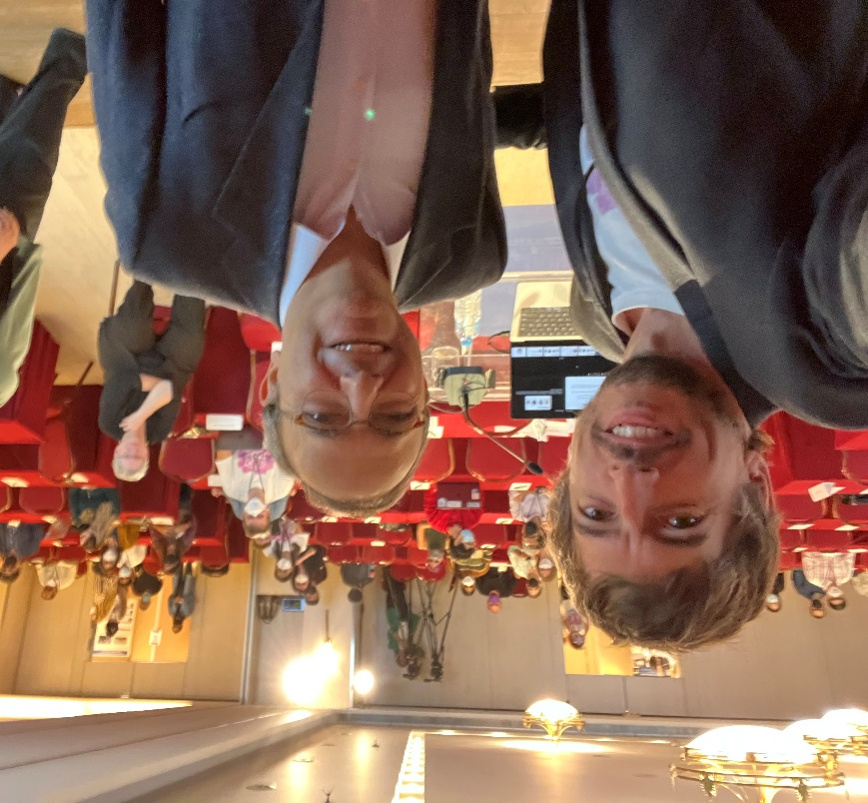
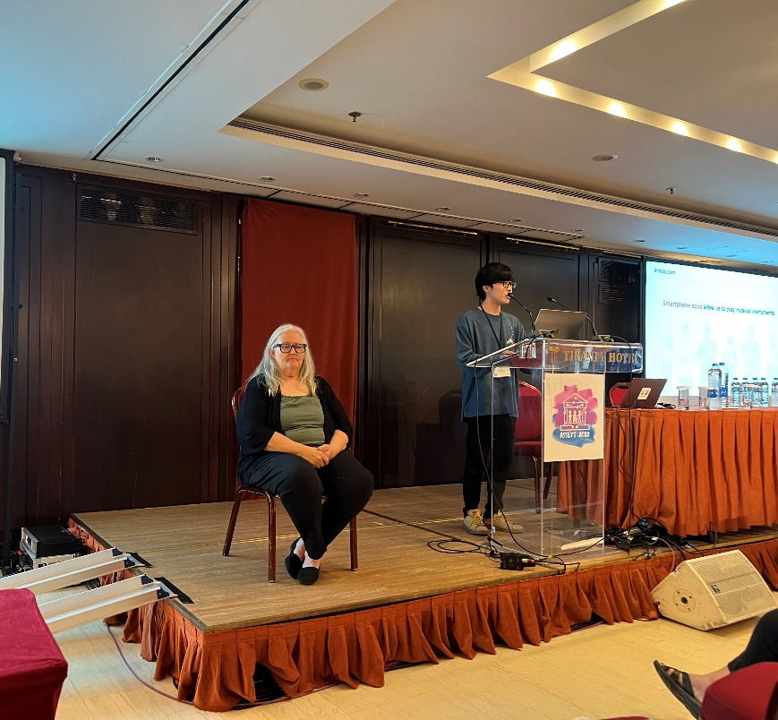
ASSETS’22 Day 2
Talks

Slide 10
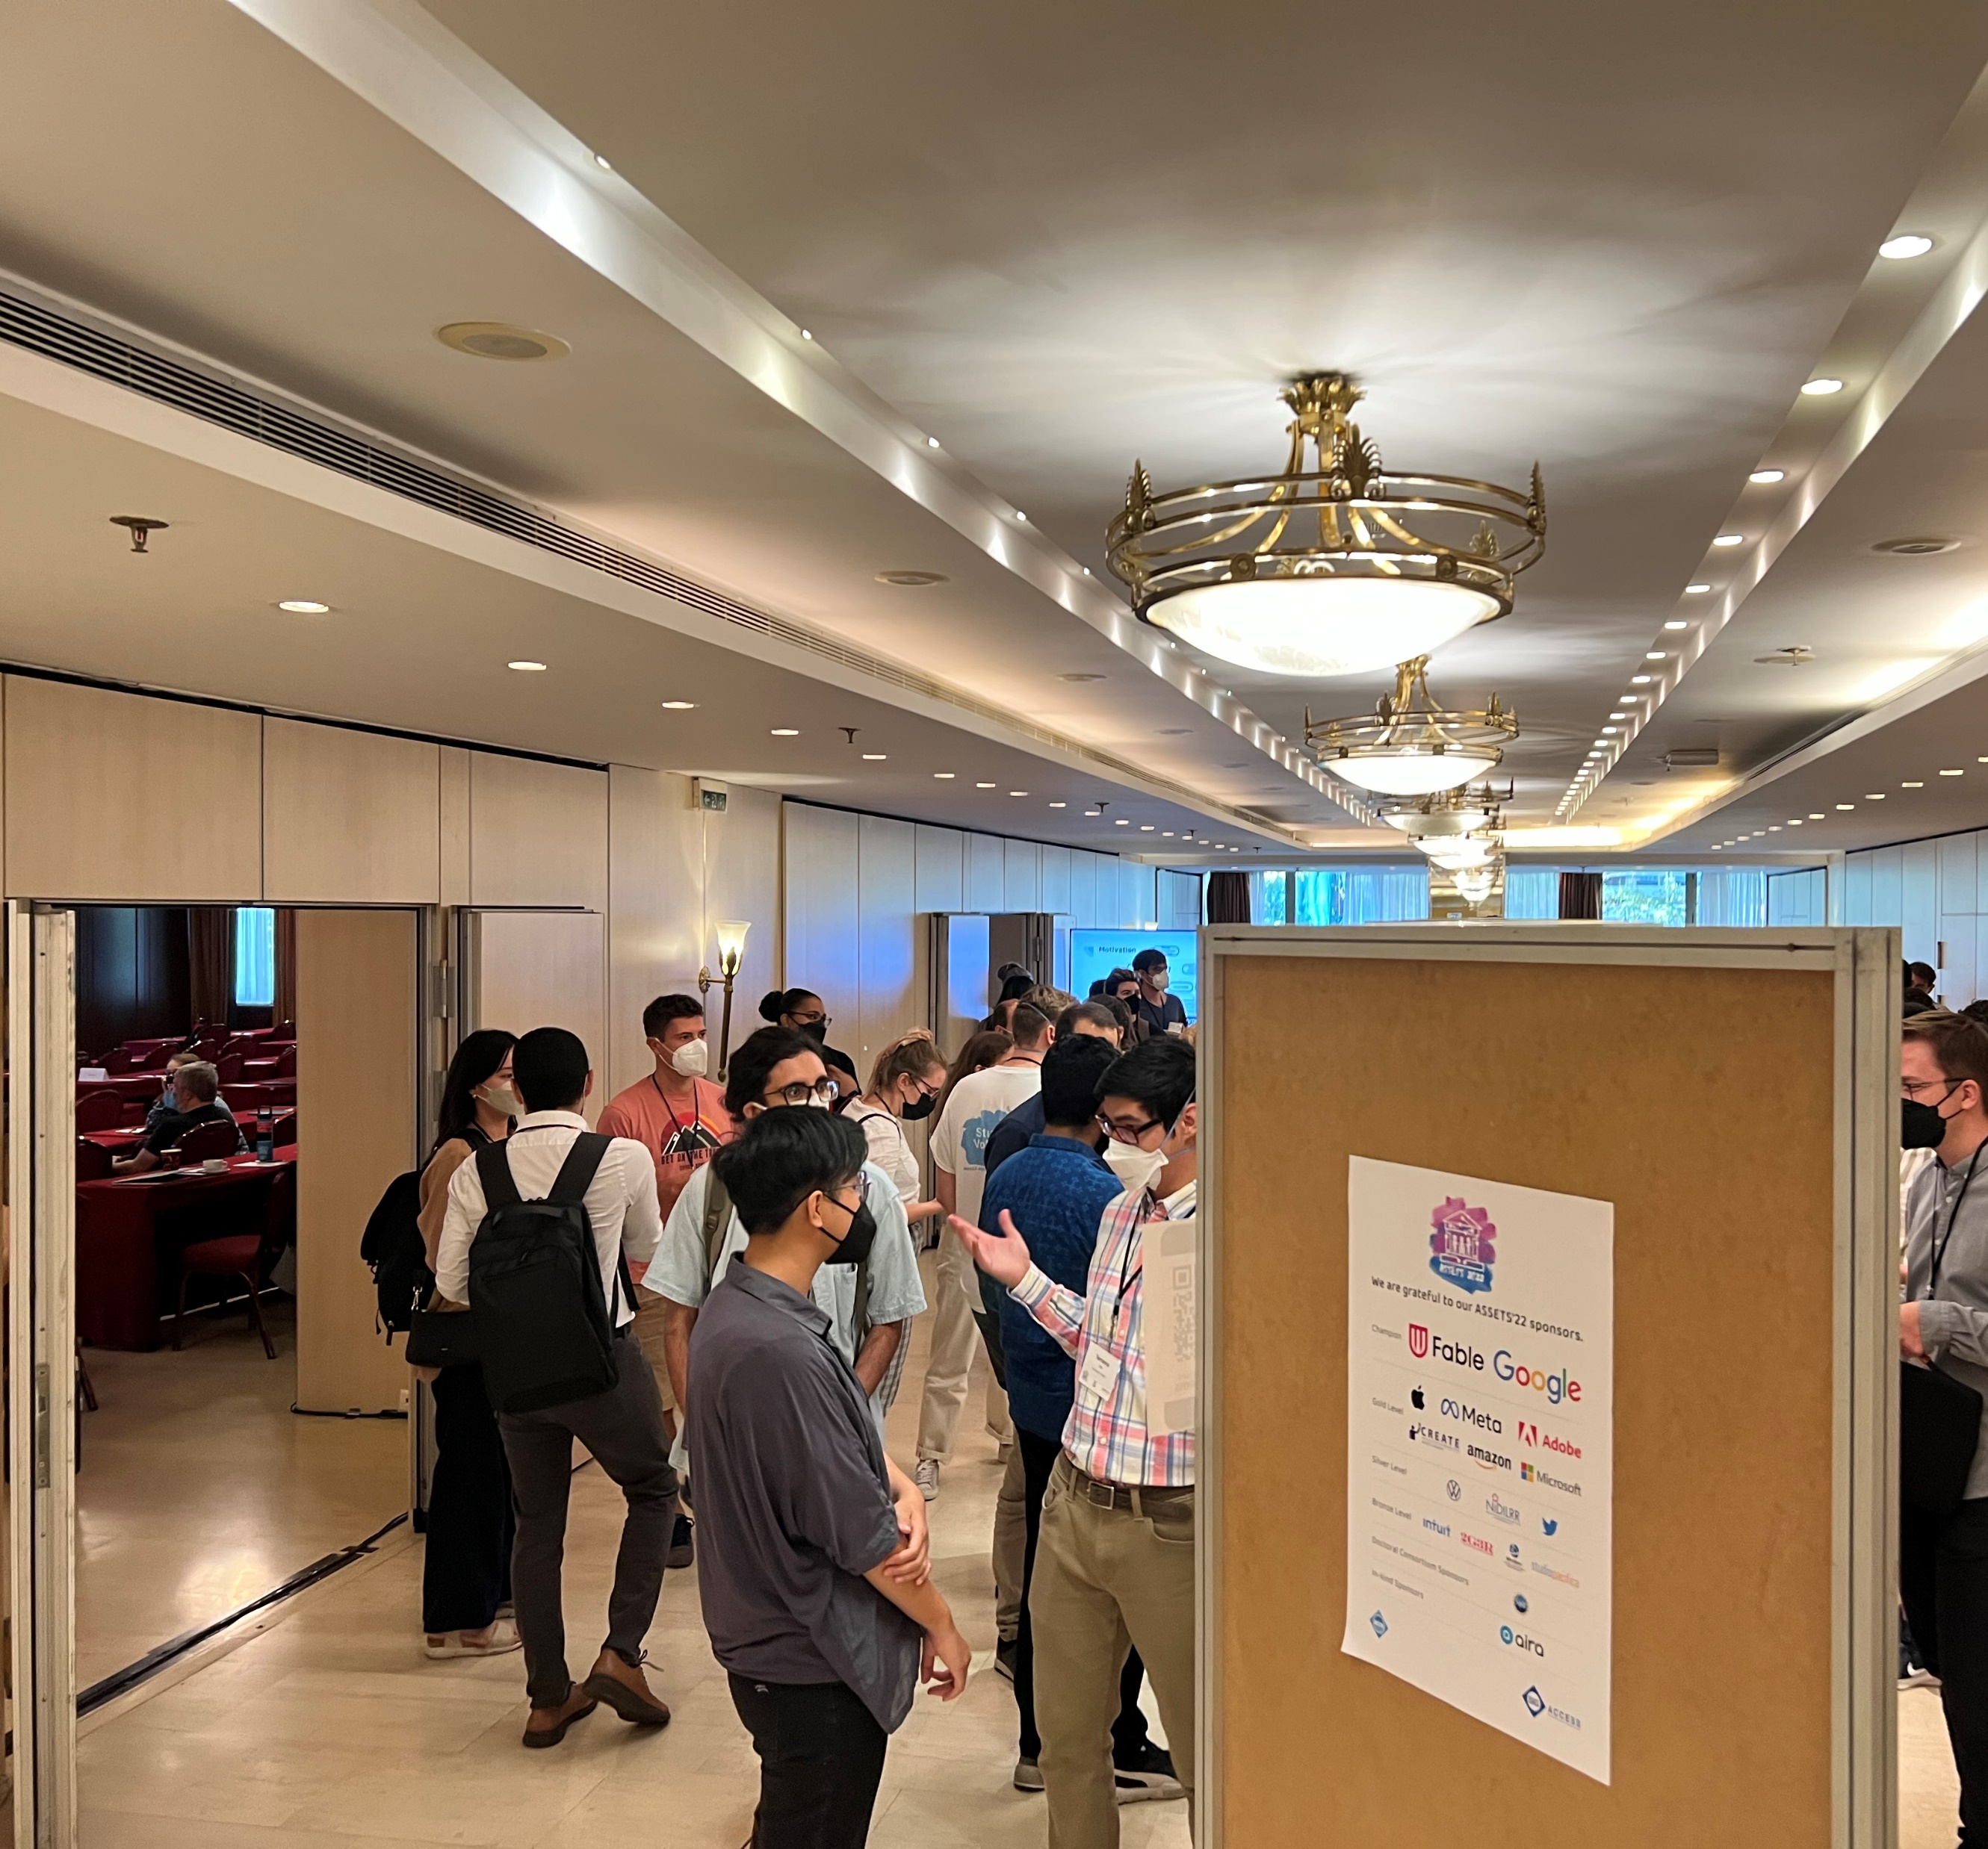
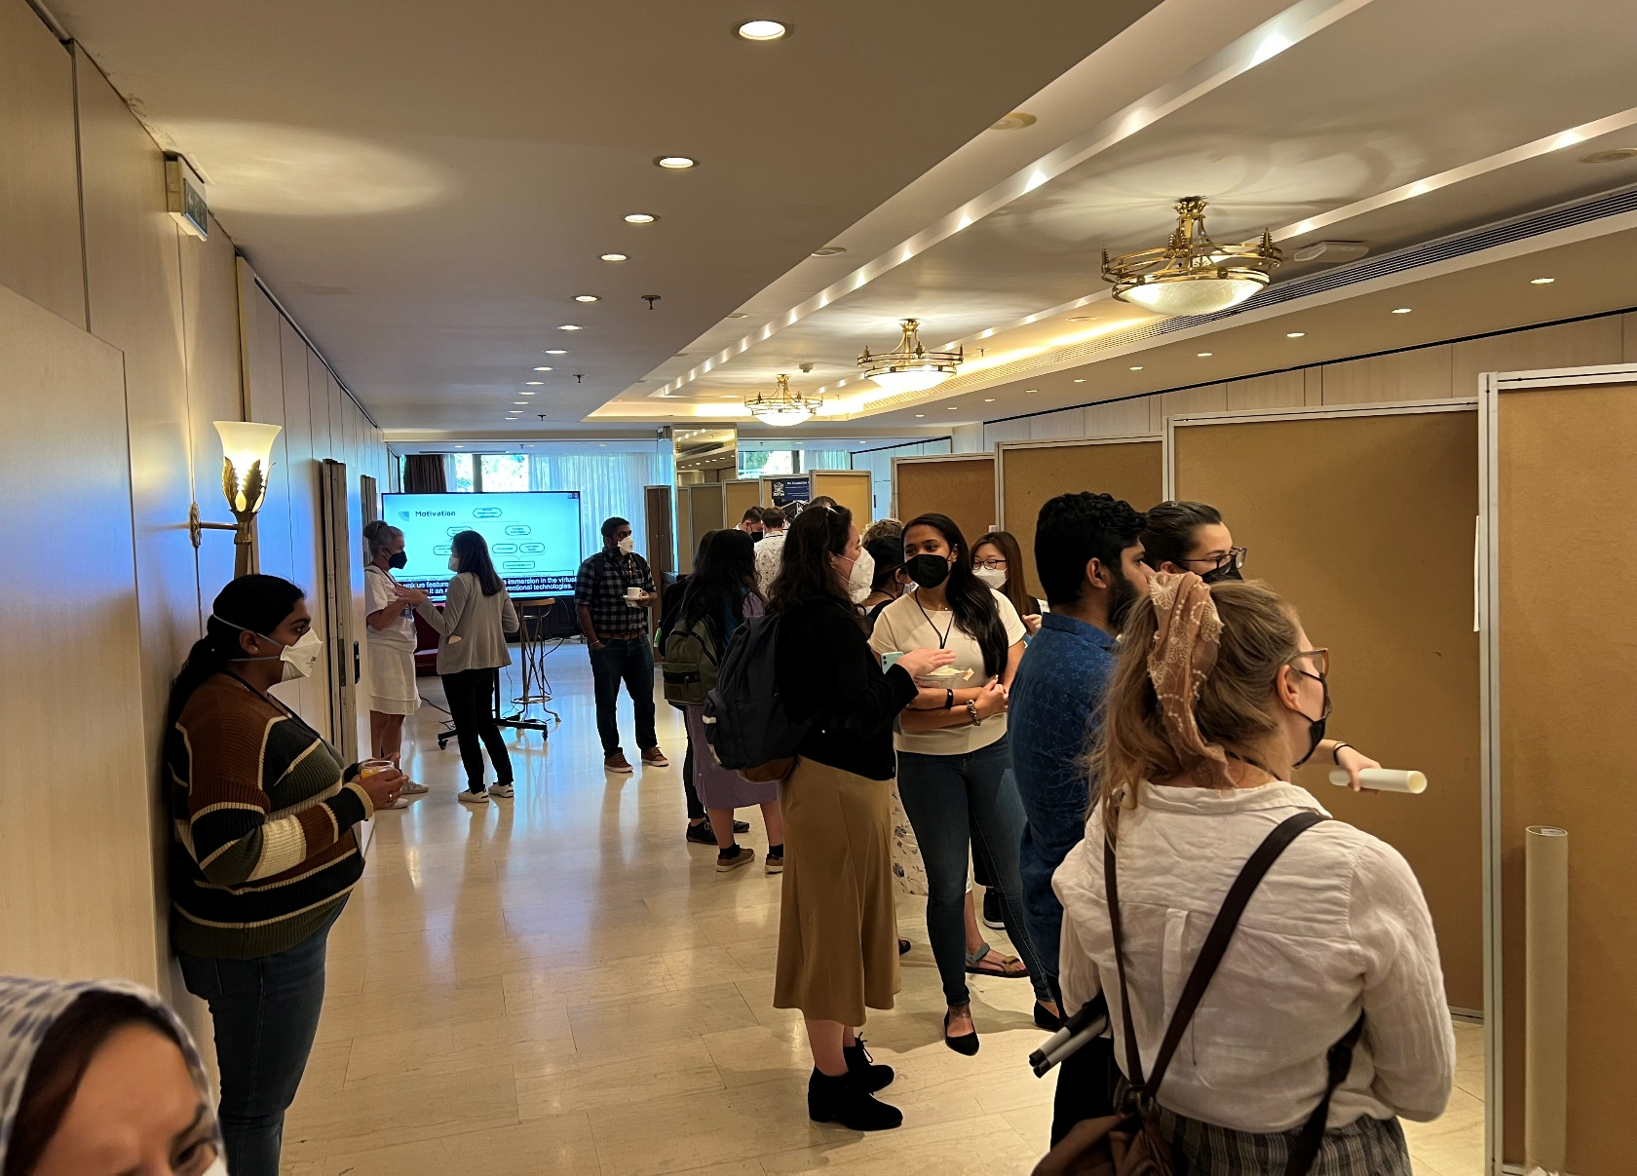
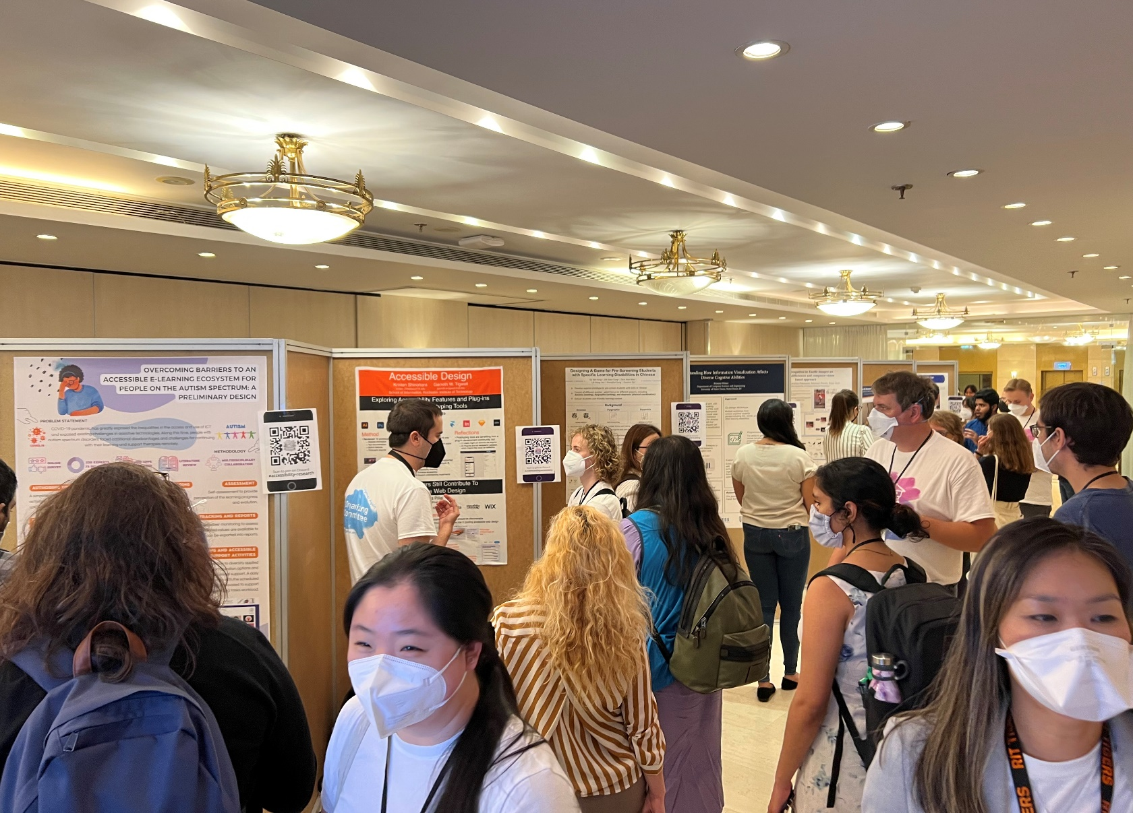
ASSETS’22 Day 2
Poster Session

Slide 11
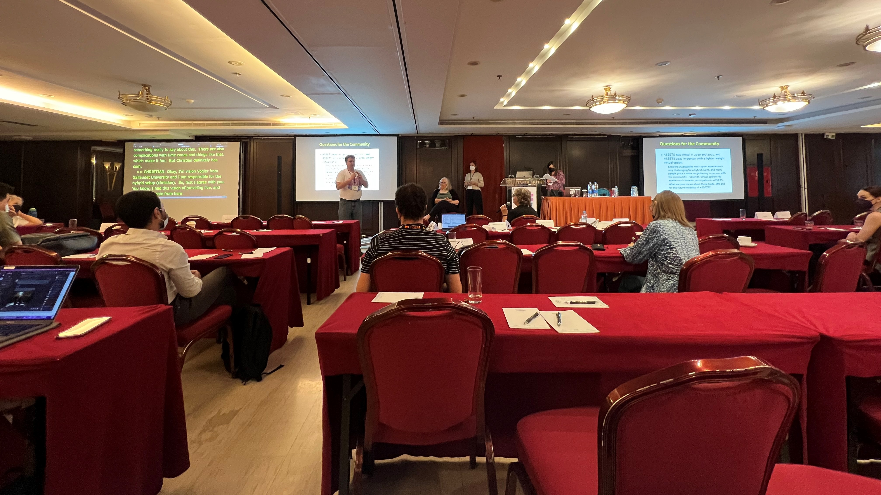
ASSETS’22 Day 2
Townhall

Slide 12

Join SIGACCESS
Join SIGACCESS!

Slide 13
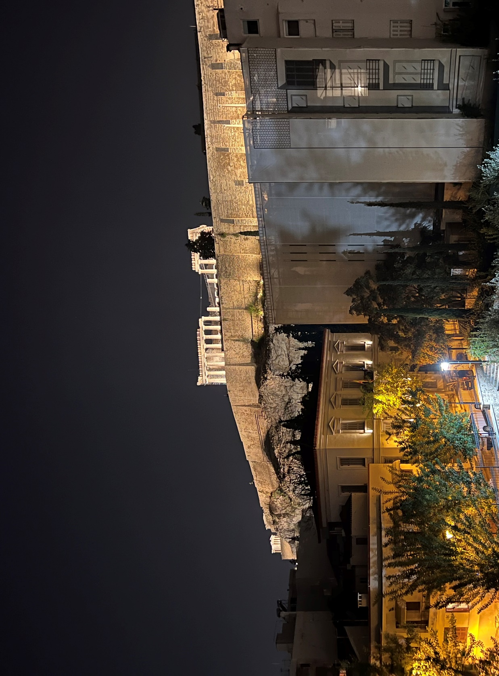
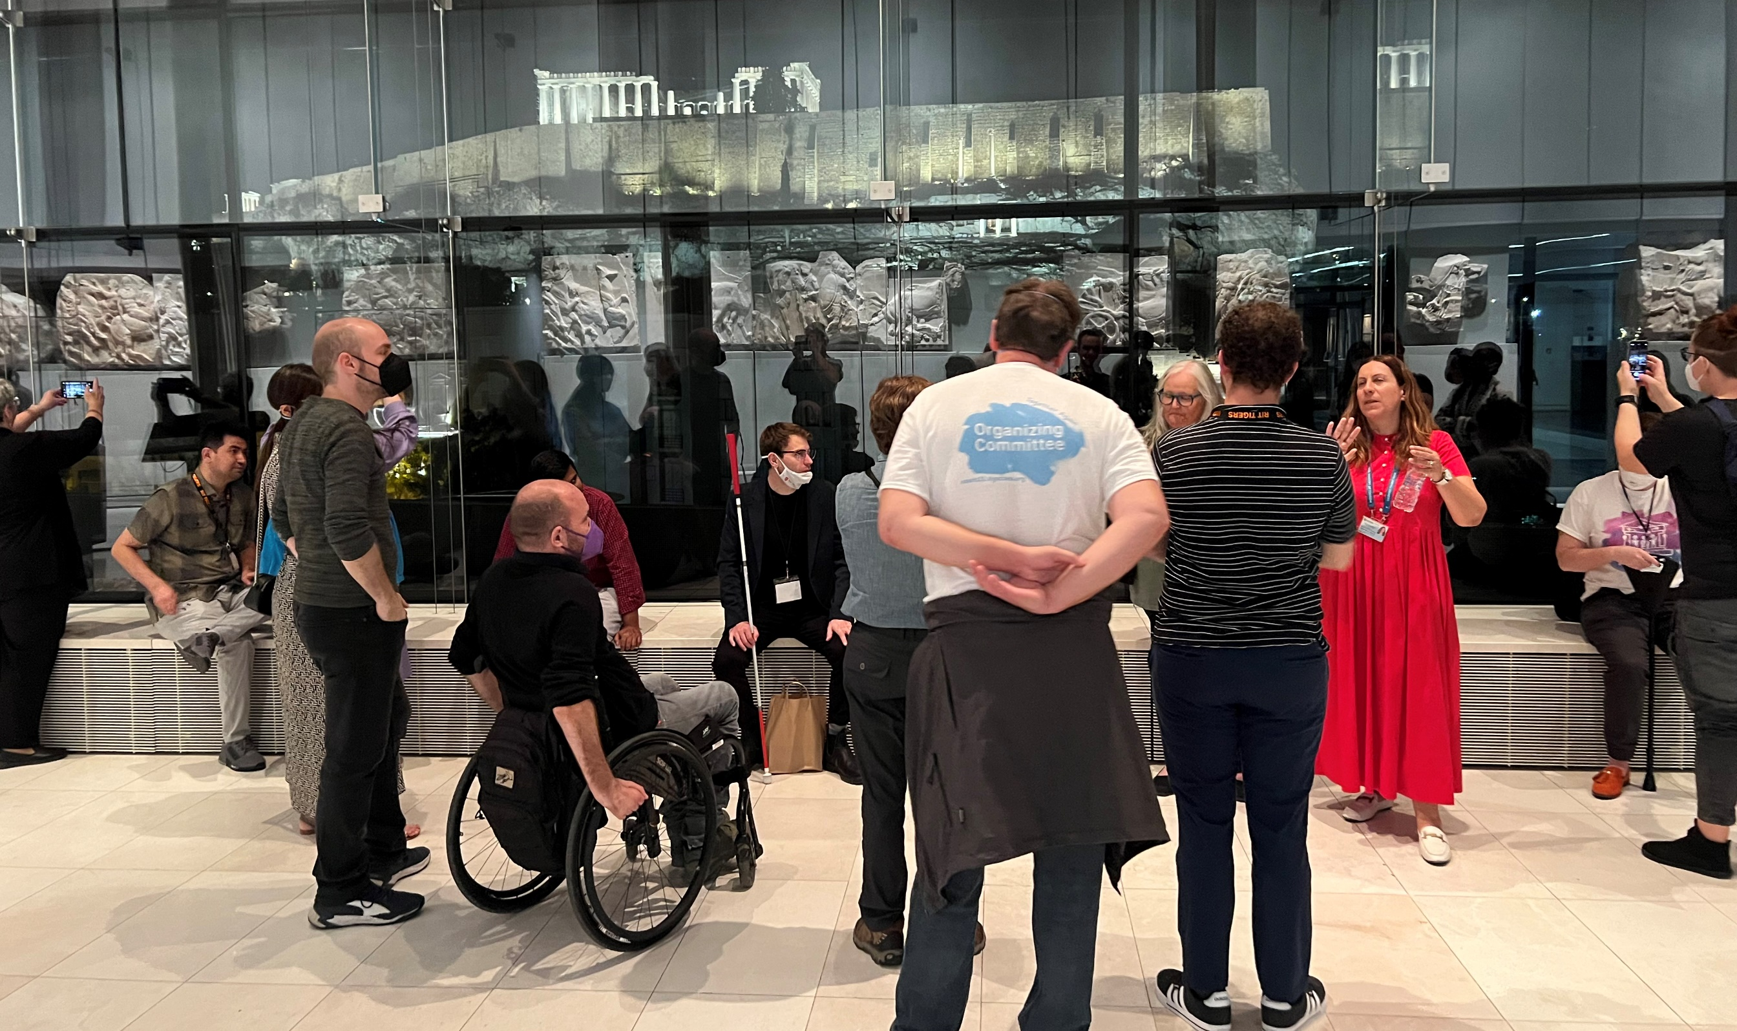
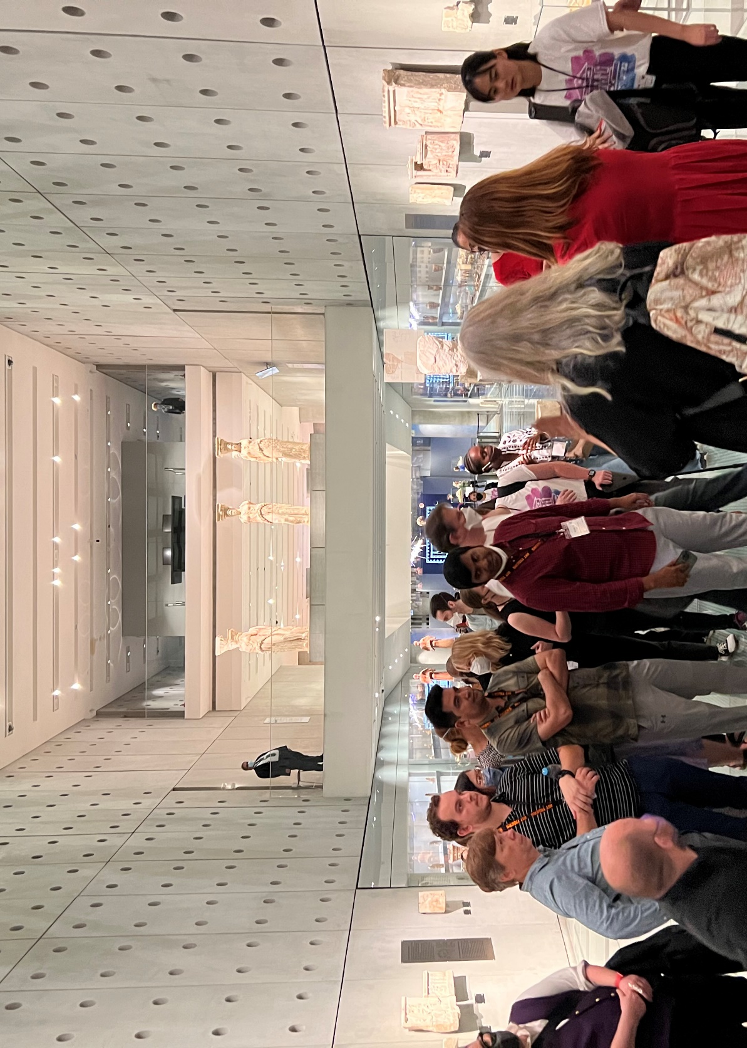
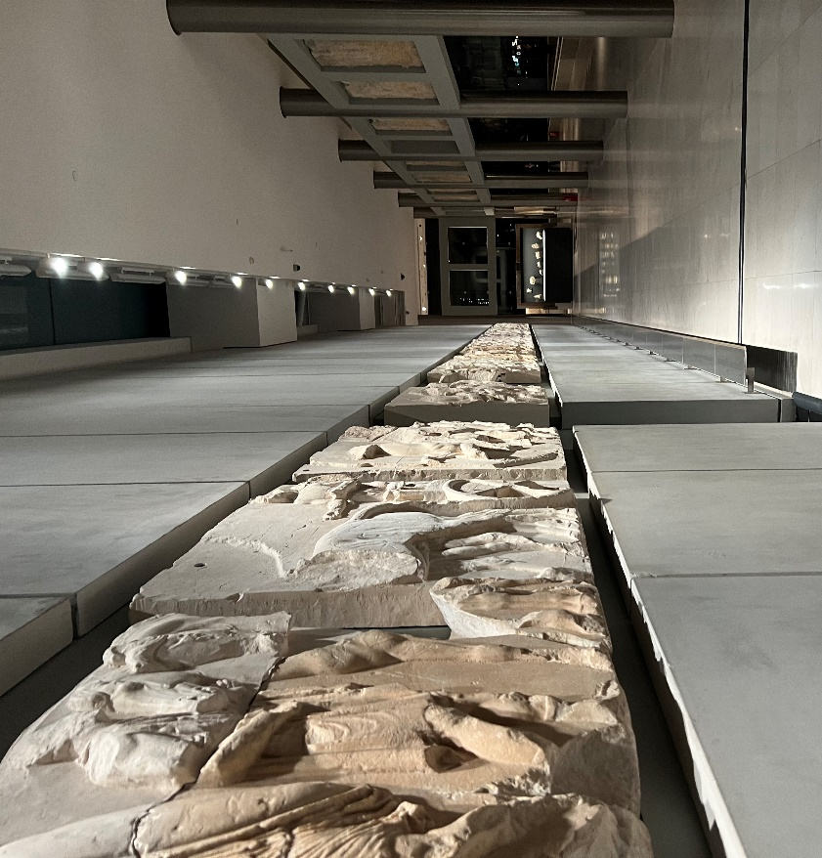
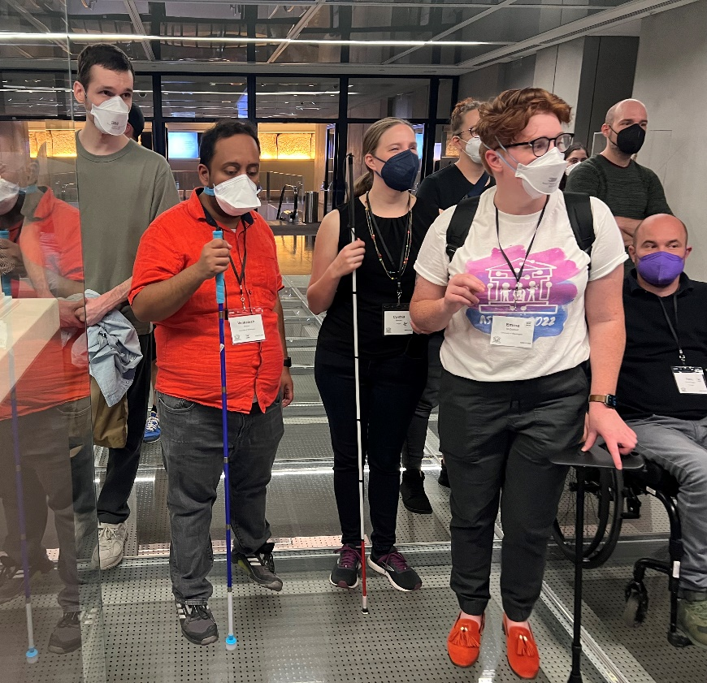
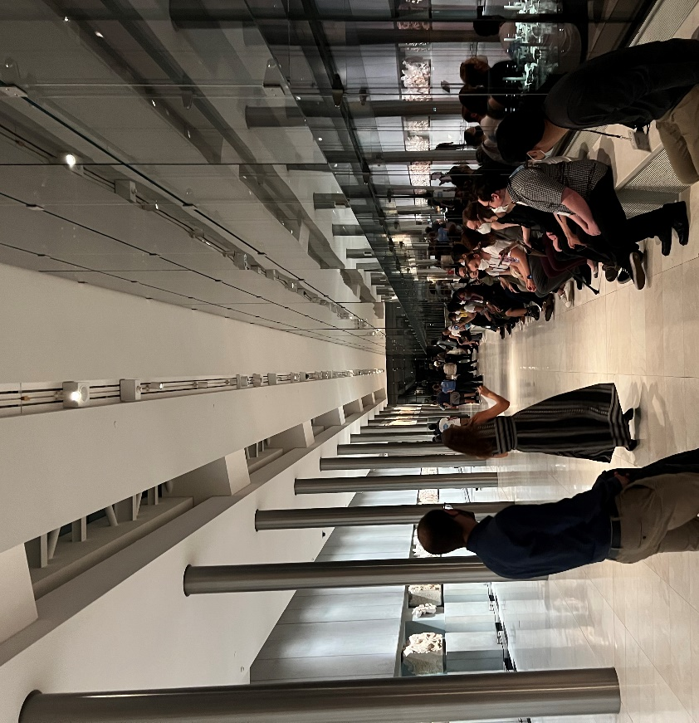
ASSETS’22 Day 2
Acropolis Museum

Slide 14
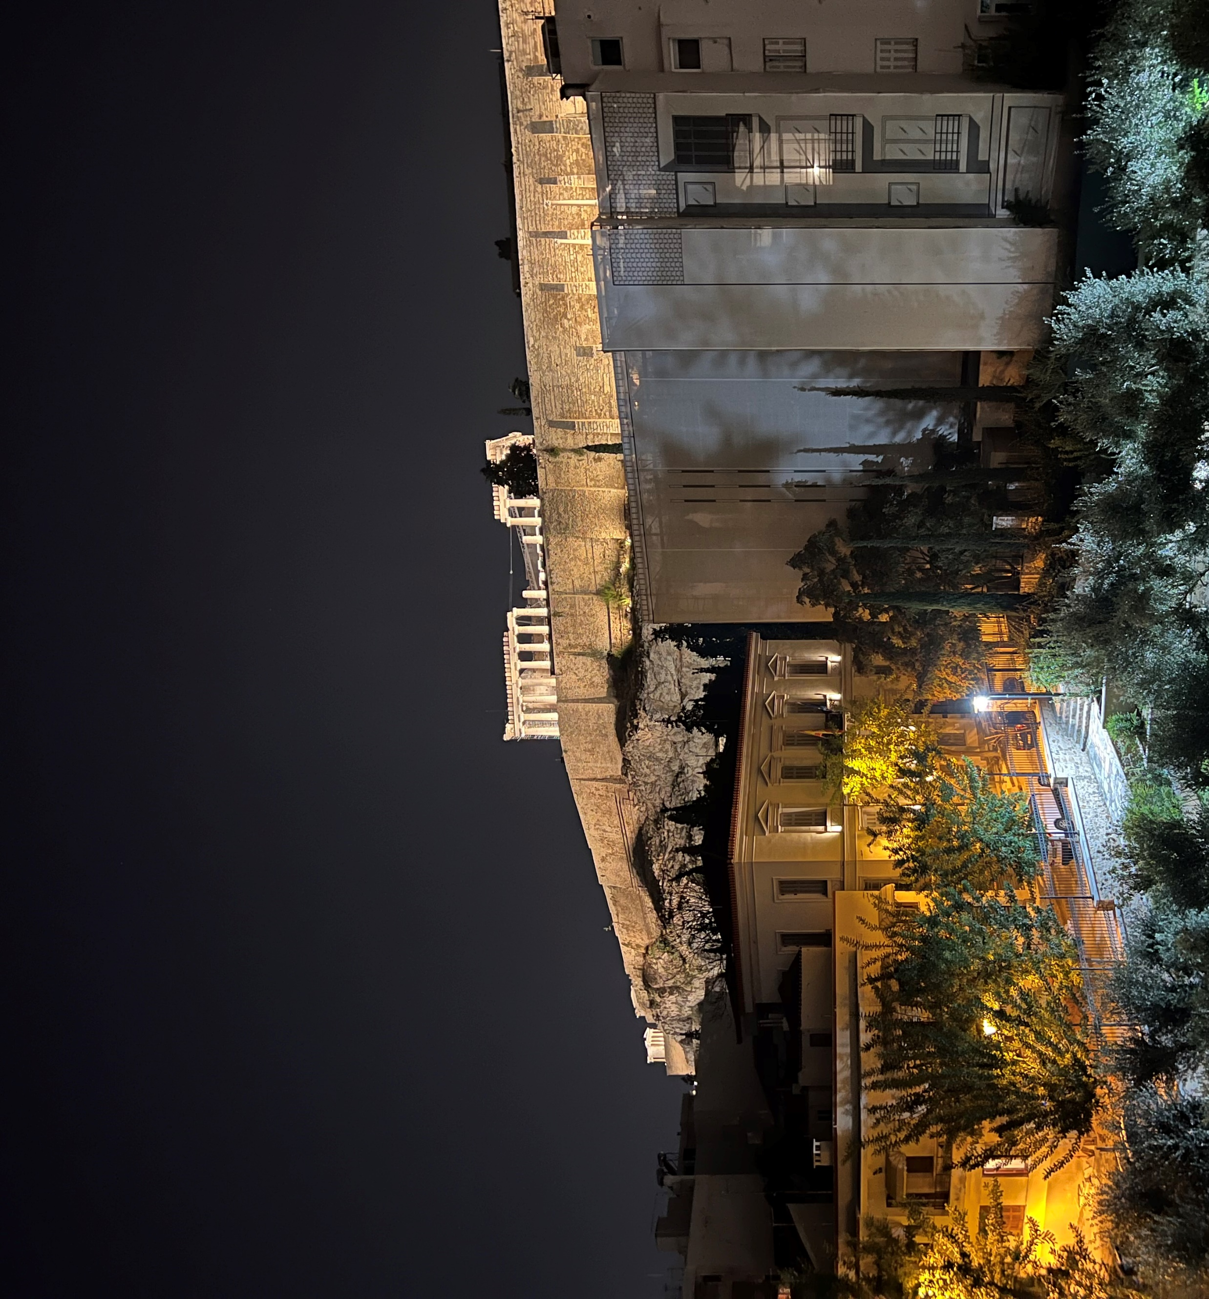
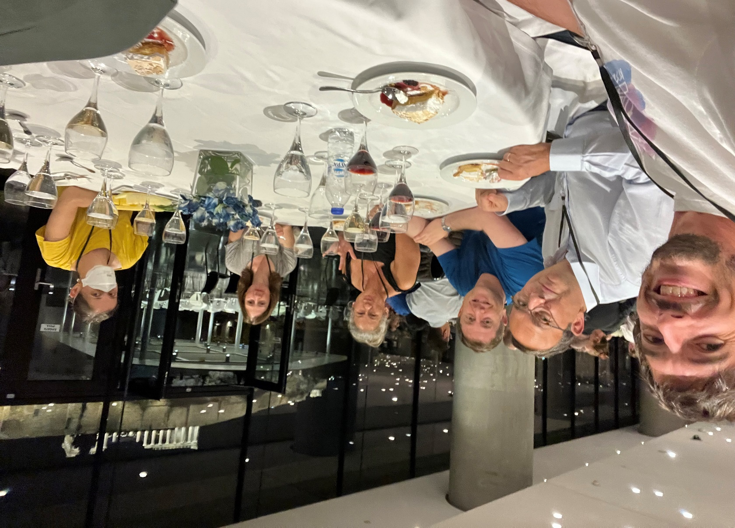
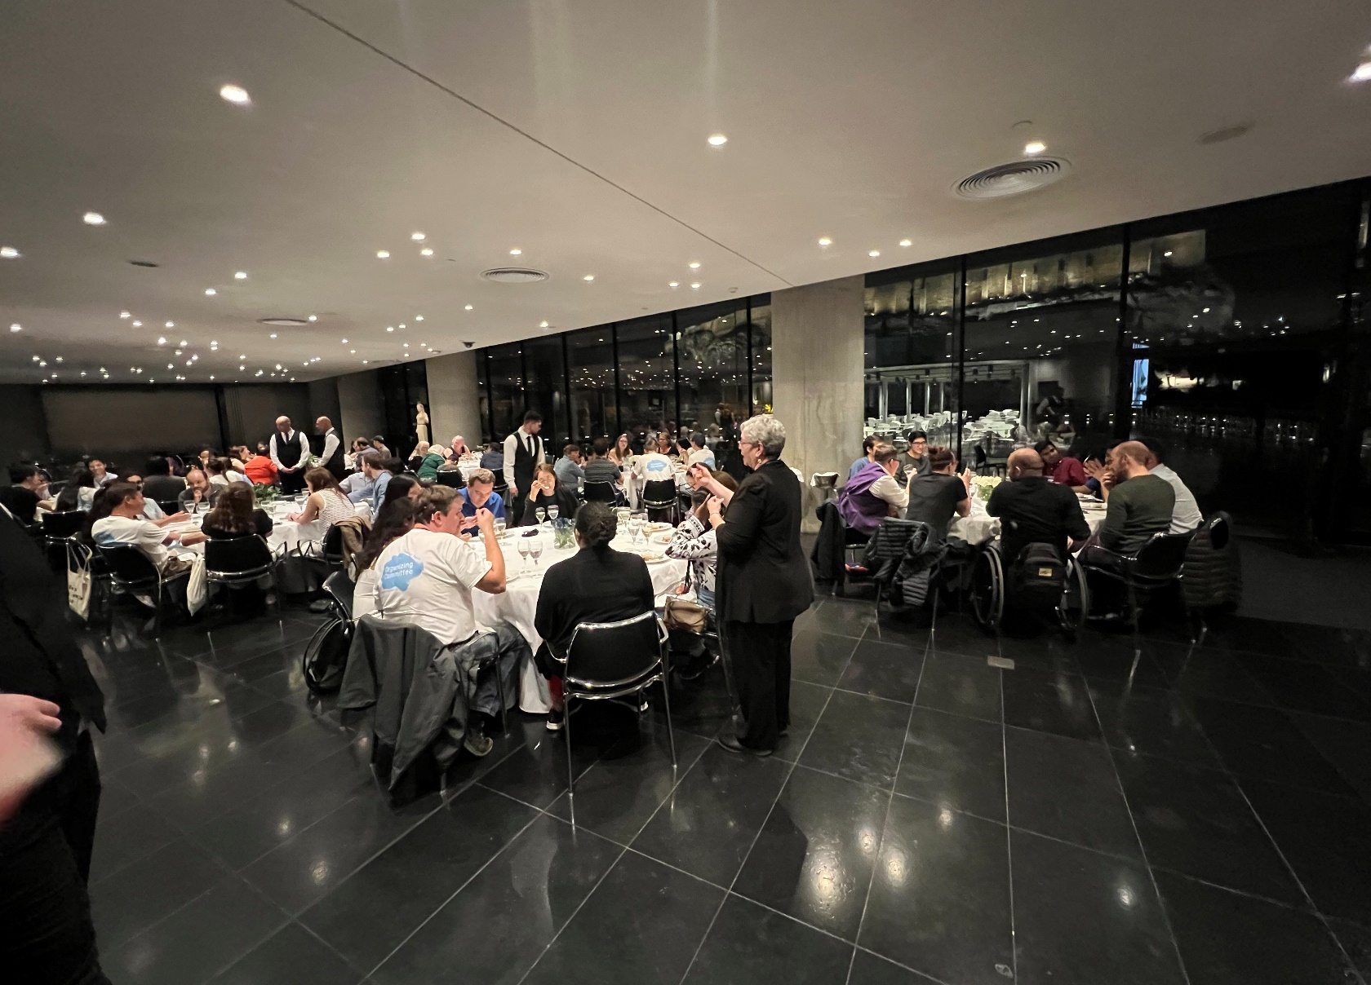
ASSETS’22 Day 2
Acropolis Cafe
Notes:
A selfie with ACM President Yannia Ioaniddis, Andy Begel, Louanne Boyd, Karyn Moffat, and Leah Findlater

Slide 15
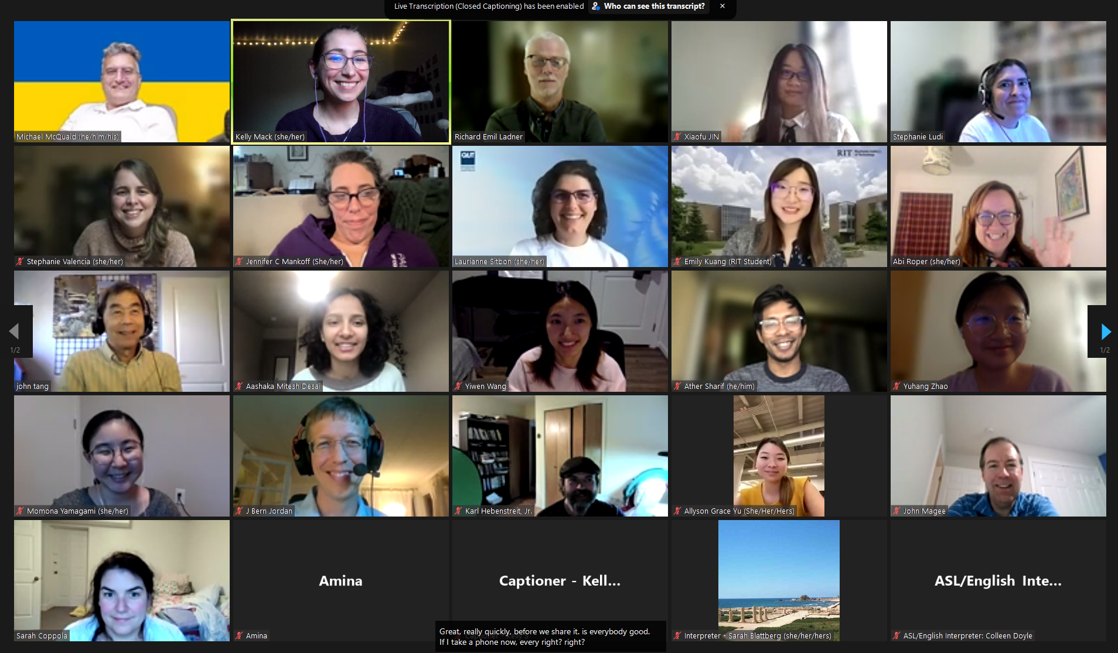
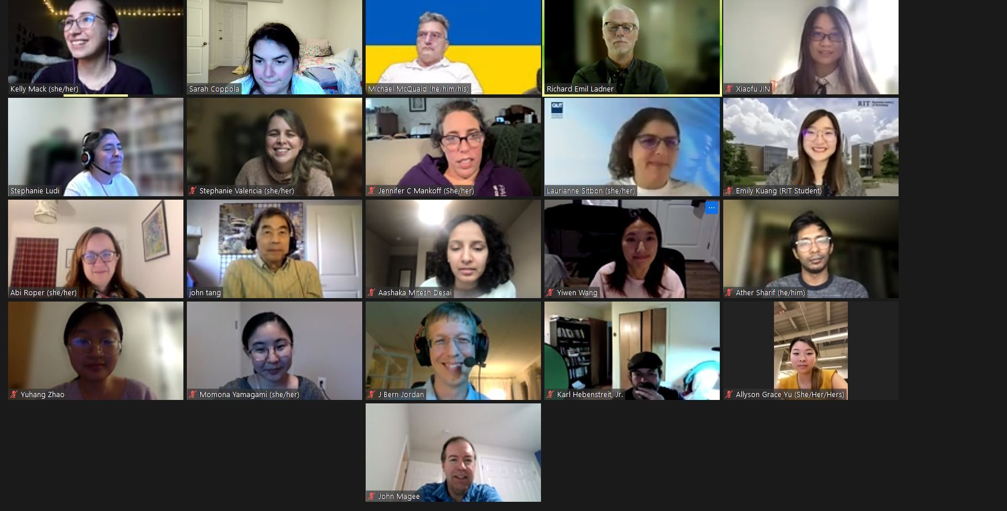
ASSETS’22 Day 2
Virtual Roundtable
Notes:
Thank Laurianne Sitbon and Kelly Mack

Slide 16
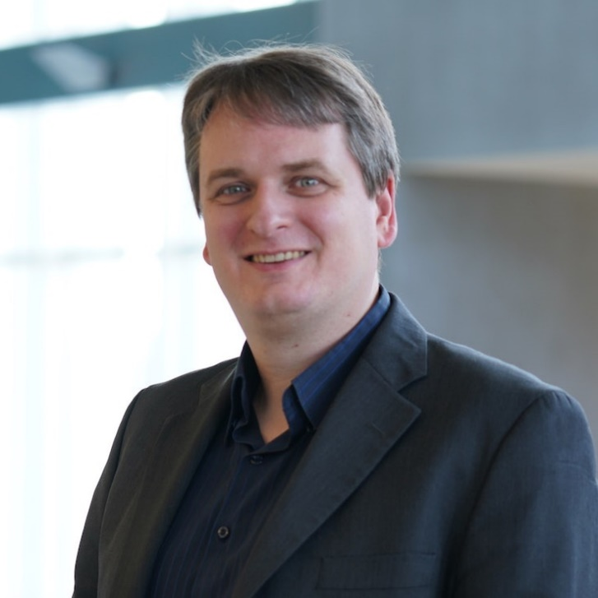
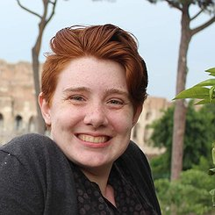
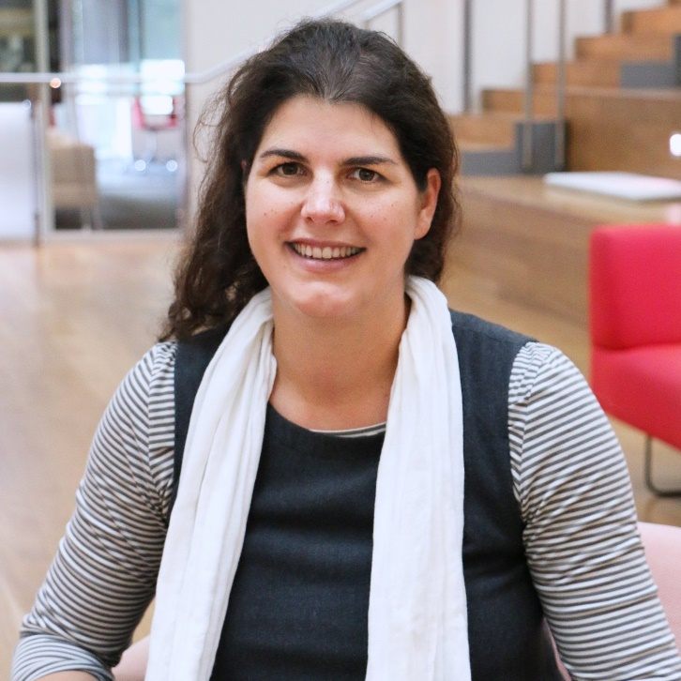
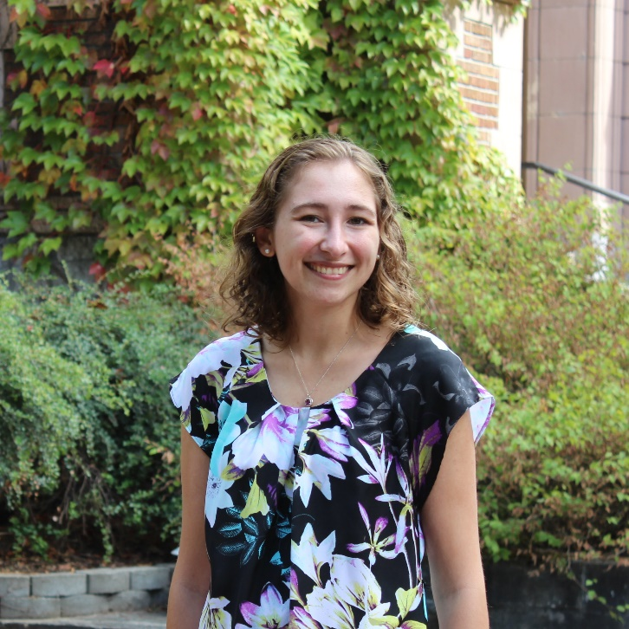
Hybrid/Virtual Chairs
ASSETS’22
Christian Vogler
Gallaudet University
Emma McDonnell
UW
Laurianne Sitbon
Queensland U. of Tech
Kelly Mack
UW

Slide 17
Thank Yous
Notes:
And all of this is because of the incredible work of the community… so allow me just a few moments for thank yous

Slide 18

49 Organizing Committee
49
15
Countries
Organizing Committee
Notes:
49 members of the organizing committee from 15 countries, many who went above and beyond planning both virtual and in-person components

Slide 19
Thank you Organizing Committee
ASSETS’22
General Chair, Jon E. Froehlich Technical Program Chairs, Kristen Shinohara; Stephanie Ludi Treasurer and Registration Chairs, Martez Mott; Kyle Rector Hybrid Experience Chair, Christian Vogler Proceedings Chair, Raja Kushalnagar; Sergio Mascetti Local Chairs, Georgios Kouroupetroglou, Alexandros Pino Local Access Chairs, Paraskevi Riga, Ariadni Velissaropoulou Web and Graphic Chairs, Liang He, Junhan (Judy) Kong, Jaylin Herskovitz, Jason Wu ACM Partnerships Chair, Stacy Branham Global Outreach Chairs, Uran Oh, Yuhang Zhao, Manohar Swaminathan, Pin Sym Foong Workshop Chairs, Kyle Montague, Sowmya Somanath Education and Outreach Chairs, Anne Spencer Ross, Catie Baker Equity and Belonging Chairs, LouAnne Boyd, John A. Guerra Gomez Virtual Chairs, Emma McDonnell, Kelly Mack, Benjamin Tannert, Laurianne Sitbon Accessibility Chairs, J. Bern Jordan, Lei Shi Mentoring Chairs, Sayan Sarcar, Kirsten Ellis Publicity Chairs, Alexa Siu, Arthur Theil Student Volunteer Chairs, Franklin Mingzhe Li, Maryam Banduka TACCESS Special Issue Chair, Maria Wolters Best Artifact Chair, Dragan Ahmetovic Poster/Demo Chairs, Hugo Nicolau, Taslima Akter Doctoral Consortium Chairs, Katta Spiel, Aqueasha Martin-Hammond Student Research Competition Chairs, Mingming Fan, Roshan Peiris Experience Report Chairs, Garreth Tigwell, Kathryn (Kate) Ringland

Slide 20
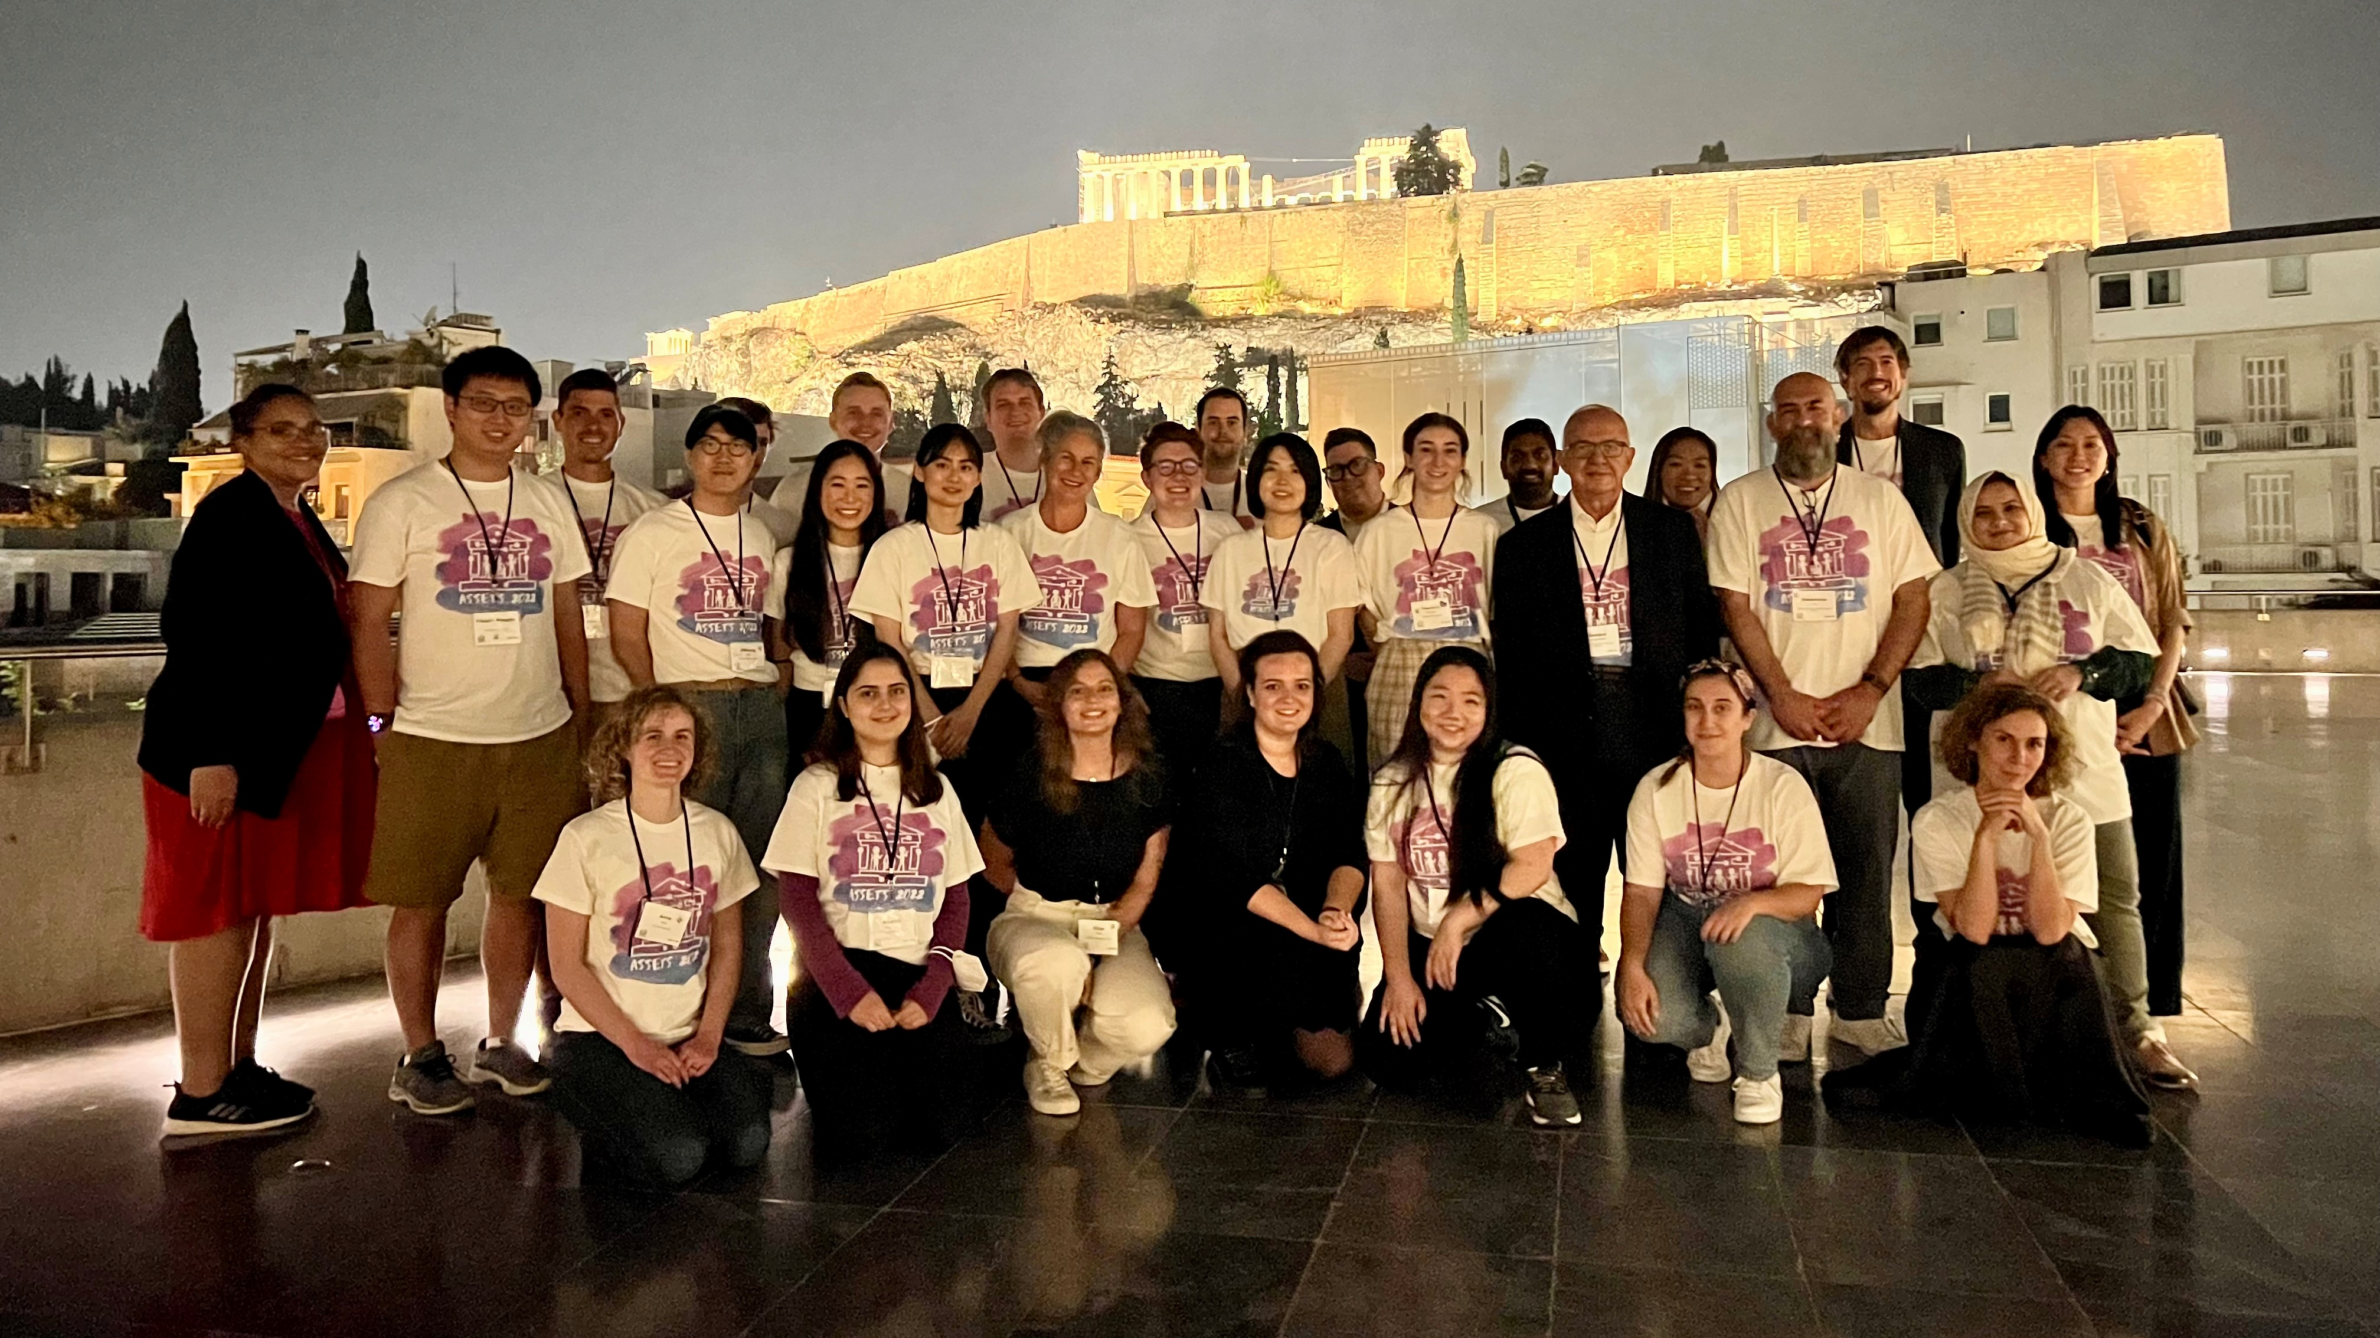
ASSETS’22 Photo of OC and Student Volunteers

Slide 21
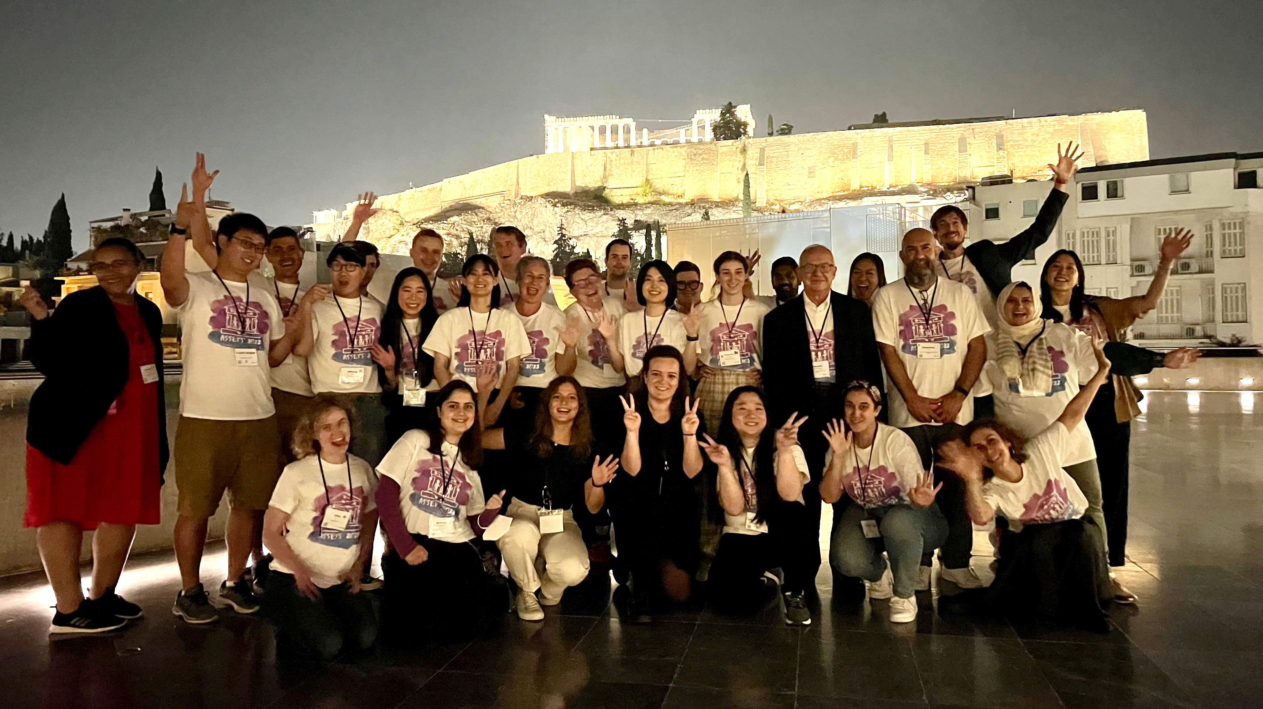
ASSETS’22 Photo of OC and Student Volunteers 2

Slide 22
73 Program Committee Members
73
Program Committee
Notes:
73 program committee members

Slide 23
Thank you program committee
ASSETS’22
Tousif Ahmed, Samsung Research, USA
Dragan Ahmetovic, Università degli Studi di Milano, Italy
Taslima Akter, Indiana University, USA
Oliver Alonzo, Rochester Institute of Technology, USA
Catherine Baker, Creighton University, USA
Giulia Barbareschi, Keio University, Japan
Andrew Begel, Microsoft Research, USA
Jeffrey Bigham, Carnegie Mellon Univ & Apple Research, USA
Syed Masum Billah, Pennsylvania State University, USA
Edward Cutrell, Microsoft Research, USA
Karina Caro, Autonomous University of Baja California, Mexico
Michael Crabb, University of Dundee, UK
Patrick Carrington, Carnegie Mellon University, USA
Maitraye Das, Northwestern University, USA
Kirsten Ellis, Monash University, Australia
Yasmine Elglaly, Western Washington University, USA
Lizbeth Escobedo, University of California, San Diego, USA
Leah Findlater, Univ of Washington & Apple Research, USA
David Flatla, University of Guelph, Canada
Kathrin Gerling, KU Leuven, Belgium
Benjamin Gorman, Bournemouth University, UK
João Guerreiro, University of Lisbon, Portugal
Tiago Guerreiro, University of Lisbon, Portugal
Anhong Guo, University of Michigan, USA
Foad Hamidi, University of Maryland, Baltimore County, USA
Kotaro Hara, Singapore Management University, Singapore
Saad Hassan, Rochester Institute of Technology, USA
Liang He, Purdue University, USA
Megan Hofmann, Carnegie Mellon University, USA
Anthony Hornof, University of Oregon, USA
Matt Huenerfauth, Rochester Institute of Technology, USA
Amy Hurst, New York University, USA
Dhruv Jain, University of Washington, USA
Hernisa Kacorri, University of Maryland, USA
Shaun Kane, Google, USA
Masatomo Kobayashi, IBM Research Tokyo, Japan
Ravi Kuber, University of Maryland, Baltimore County, USA
Sri Kurniawan, University of California, Santa Cruz, USA
Raja Kushalnagar, Gallaudet University, USA
Sooyeon Lee, Rochester Institute of Technology, USA
Clayton Lewis, University of Colorado, USA
Kyle Montague, Northumbria University, UK
Sergio Mascetti, University of Milan, Italy
Kathleen McCoy, University of Delaware, USA
Rachel Menzies, University of Dundee, UK
Oussama Metatla, University of Bristol, UK
Lauren Milne, Macalester College, USA
Silvia Mirri, University of Bologna, Italy
Karyn Moffatt, McGill University, Canada
Merrie Morris, Google, USA
Cecily Morrison, Microsoft Research, UK
Martez Mott, Microsoft Research, USA
Aboubakar Mountapmbeme, University of North Texas, USA
Tim Neate, King’s College London, UK
Hugo Nicolau, University of Lisbon, Portugal
Obianuju Okafor, University of North Texas, USA
Roshan Peiris, Rochester Institute of Technology
Cynthia Putnam, DePaul University, USA
Kathryn Ringland, University of California, Santa Cruz, USA
André Rodrigues, University of Lisbon, Portugal
Abi Roper, City University of London, UK
Abigale Stangl, University of Washington, USA
Sayan Sarcar, Birmingham City University, UK
Daisuke Sato, IBM Research Tokyo, Japan
Lei Shi, Google, USA
Manohar Swaminathan, Microsoft Research, India
Hironobu Takagi, IBM Research Tokyo, Japan
Benjamin Tannert, Bremen City Univ of Applied Science, Germany
Arthur Theil, Offenburg University of Applied Sciences, Germany
Gerhard Weber, Dresden University of Technology, Germany
Maria Wolters, University of Edinburgh, UK
Shaomei Wu, Facebook, USA
Yuhang Zhao, University of Wisconsin-Madison, USA

Slide 24
46 Student Volunteers
46
Student Volunteers
8 in-person | 38 virtual
Notes:
50 student volunteers -- 10 in person and 40 virtual

Slide 25
THANK YOU STUDENT VOLUNTEERS
ASSETS’22
Alexandre Nevsky, King's College London
Allyson Yu, Temple University
Bineeth Kuriakose, Oslo Metropolitan University (OsloMet), Oslo, Norway
Brianna Wimer, University of Notre Dame
Chen Chen, University of California San Diego
Chinatsu Ozawa, University of Tsukuba / DigitalNatureGroup
Chutian Jiang, The Hong Kong University of Science and Technology
Eleftheria Maria Koukouletsou, National and Kapodistrian University of Athens, Department of Psychology
Filipa Rocha, University of LIsbon
Gabriele Galimberti, Università degli Studi di Milano
Gesu India, Swansea University
Humphrey Curtis, King's College London
Hyeon Jeong Byeon, Ewha Womans University
Hyeonhak Jeong, University of Seoul
Jaime Garcia, California State University, Northridge
JiWoong (Joon) Jang, Carnegie Mellon University
Katerina Malisova, Department of Product and Systems Design Engineering, University of the Aegean
Keita Ohshiro, New Jersey Institute of Technology
Lucy Jiang, Cornell University
Luis Miguel Zamudio Fuentes, CICESE- Centro de Investigación Científica y de Educación Superior de Ensenada
Madhuka De Silva, Monash University
Maria Concepcion Valdez Gastelum, CICESE
Maria Glykeria Giannouli, University of Athens
Md Javedul Ferdous, Old Dominion University
Miki Okamura, University of Tsukuba, Digital Nature Group
Mina Huh, UT Austin
Minoli Perera, Monash University
Mo Zhou, City University of Hong Kong
Noëlle Rakotondravony, Worcester Polytechnic Institute
Obianuju Okafor, University of North Texas
Pallabi Bhowmick, Indiana University Bloomington
Pauliina Baltzar, Tampere University
Petro - Foti Kamberi, National and Kapodistrian University of Athens, Department of Informatics and Telecommunications
Rie Kamikubo, University of Maryland, College Park
Rosiana Natalie, Singapore Management University
Ru Wang, UW-Madison
Shruti Mahajan, Worcester Polytechnic Institute
Si Chen, University of Illinois Urbana-Champaign
Sungmin Na, University of Seoul
Tessa Eagle, University of California, Santa Cruz
Theodora Chamaidi, University of the Aegean
Yash Bohre, IITB-Monash Research Academy
yeojin kim, Ewha Womans University
Yijing Jiang, Eindhoven University of Technology
Yunjung Bae, University of Southern California
Zhuohao Zhang, University of Washington

Slide 26
17 Sponsors
17
Sponsors
Notes:
And 17 sponsors, for which this conference would otherwise not happen

Slide 27

















ASSETS’22 Sponsors
Notes:
Let’s thank Fable

Slide 28
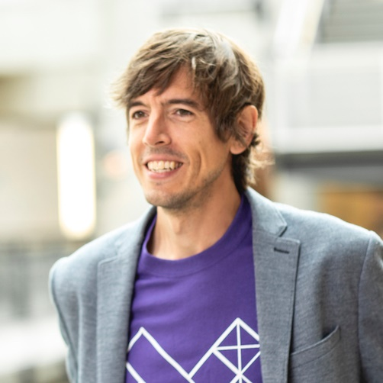
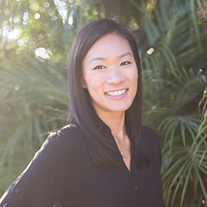
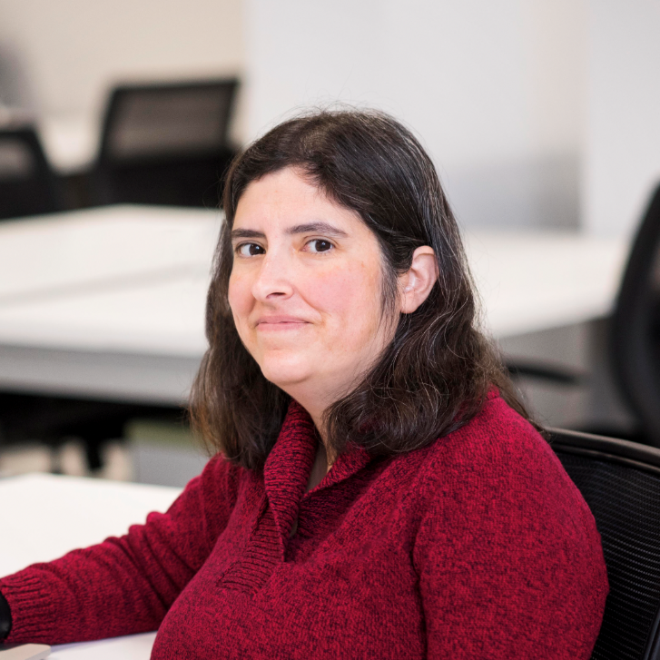
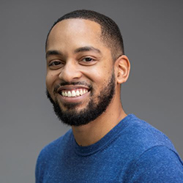
ASSETS’22 Leadership Team
Opening plenary
General Chair
Technical Program Chairs
Treasurer / Registration Chair
Hybrid Experience Chair
Jon E. Froehlich
University of Washington
Kristen Shinohara
Rochester Institute of Technology
Stephanie Ludi
University of North Texas
Martez Mott
Microsoft Research
Christian Vogler
Gallaudet University
Notes:
I’m Jon Froehlich, an Associate Professor in Computer Science at UW and the General Chair of ASSETS2022
On behalf of our ASSETS leadership team and the entire Organizing Committee, it is my tremendous pleasure to welcome you to ASSETS in Greece

Slide 29
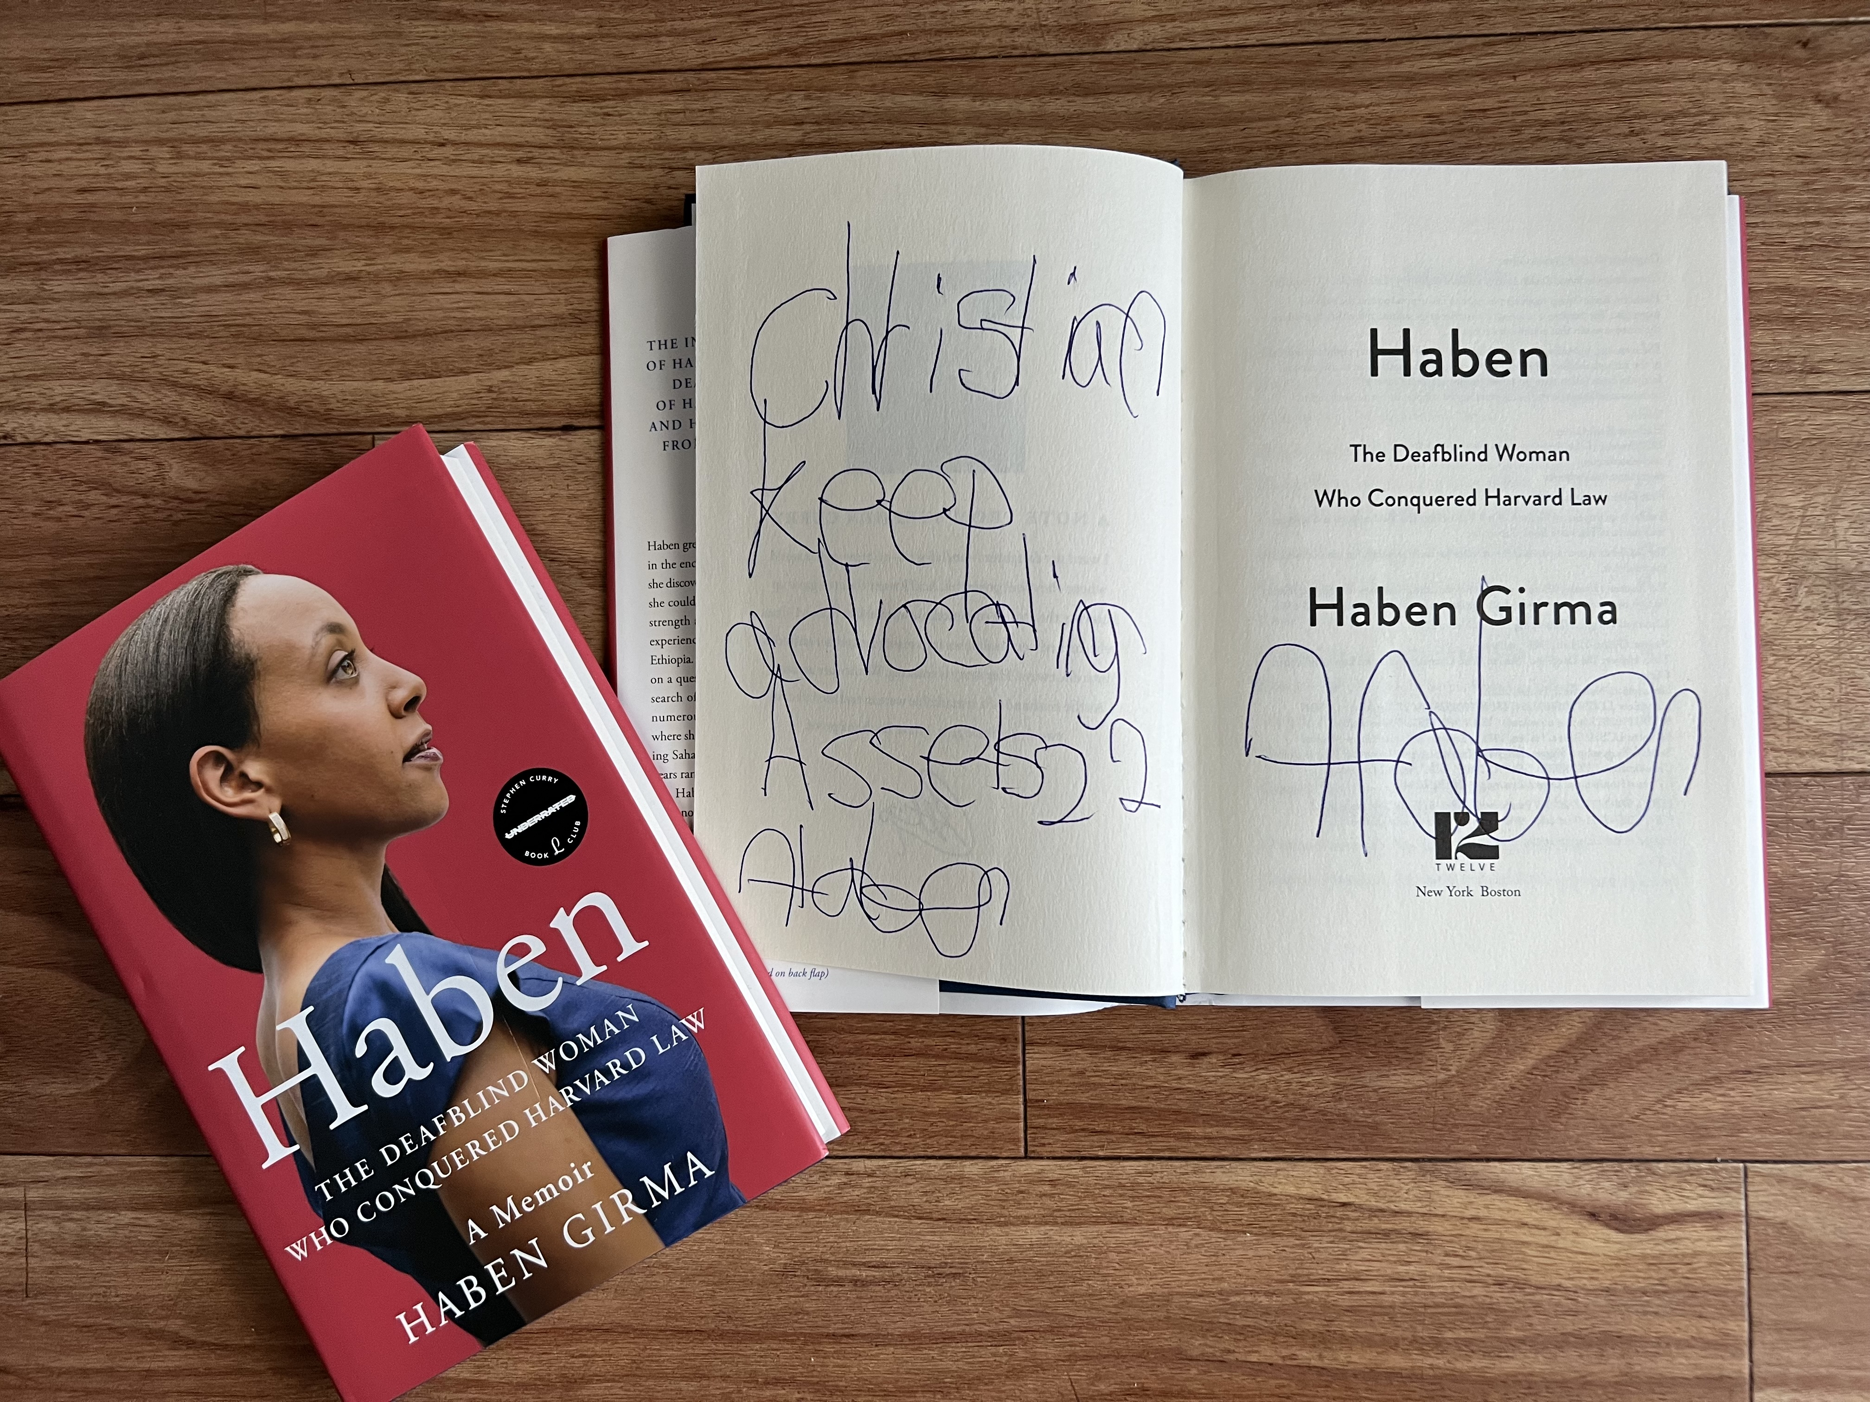
Haben Girma Signed Books

Slide 30
ASSETS’22 Hybrid Bingo
Notes:
We have a similarly exciting program for Day 2

Slide 31
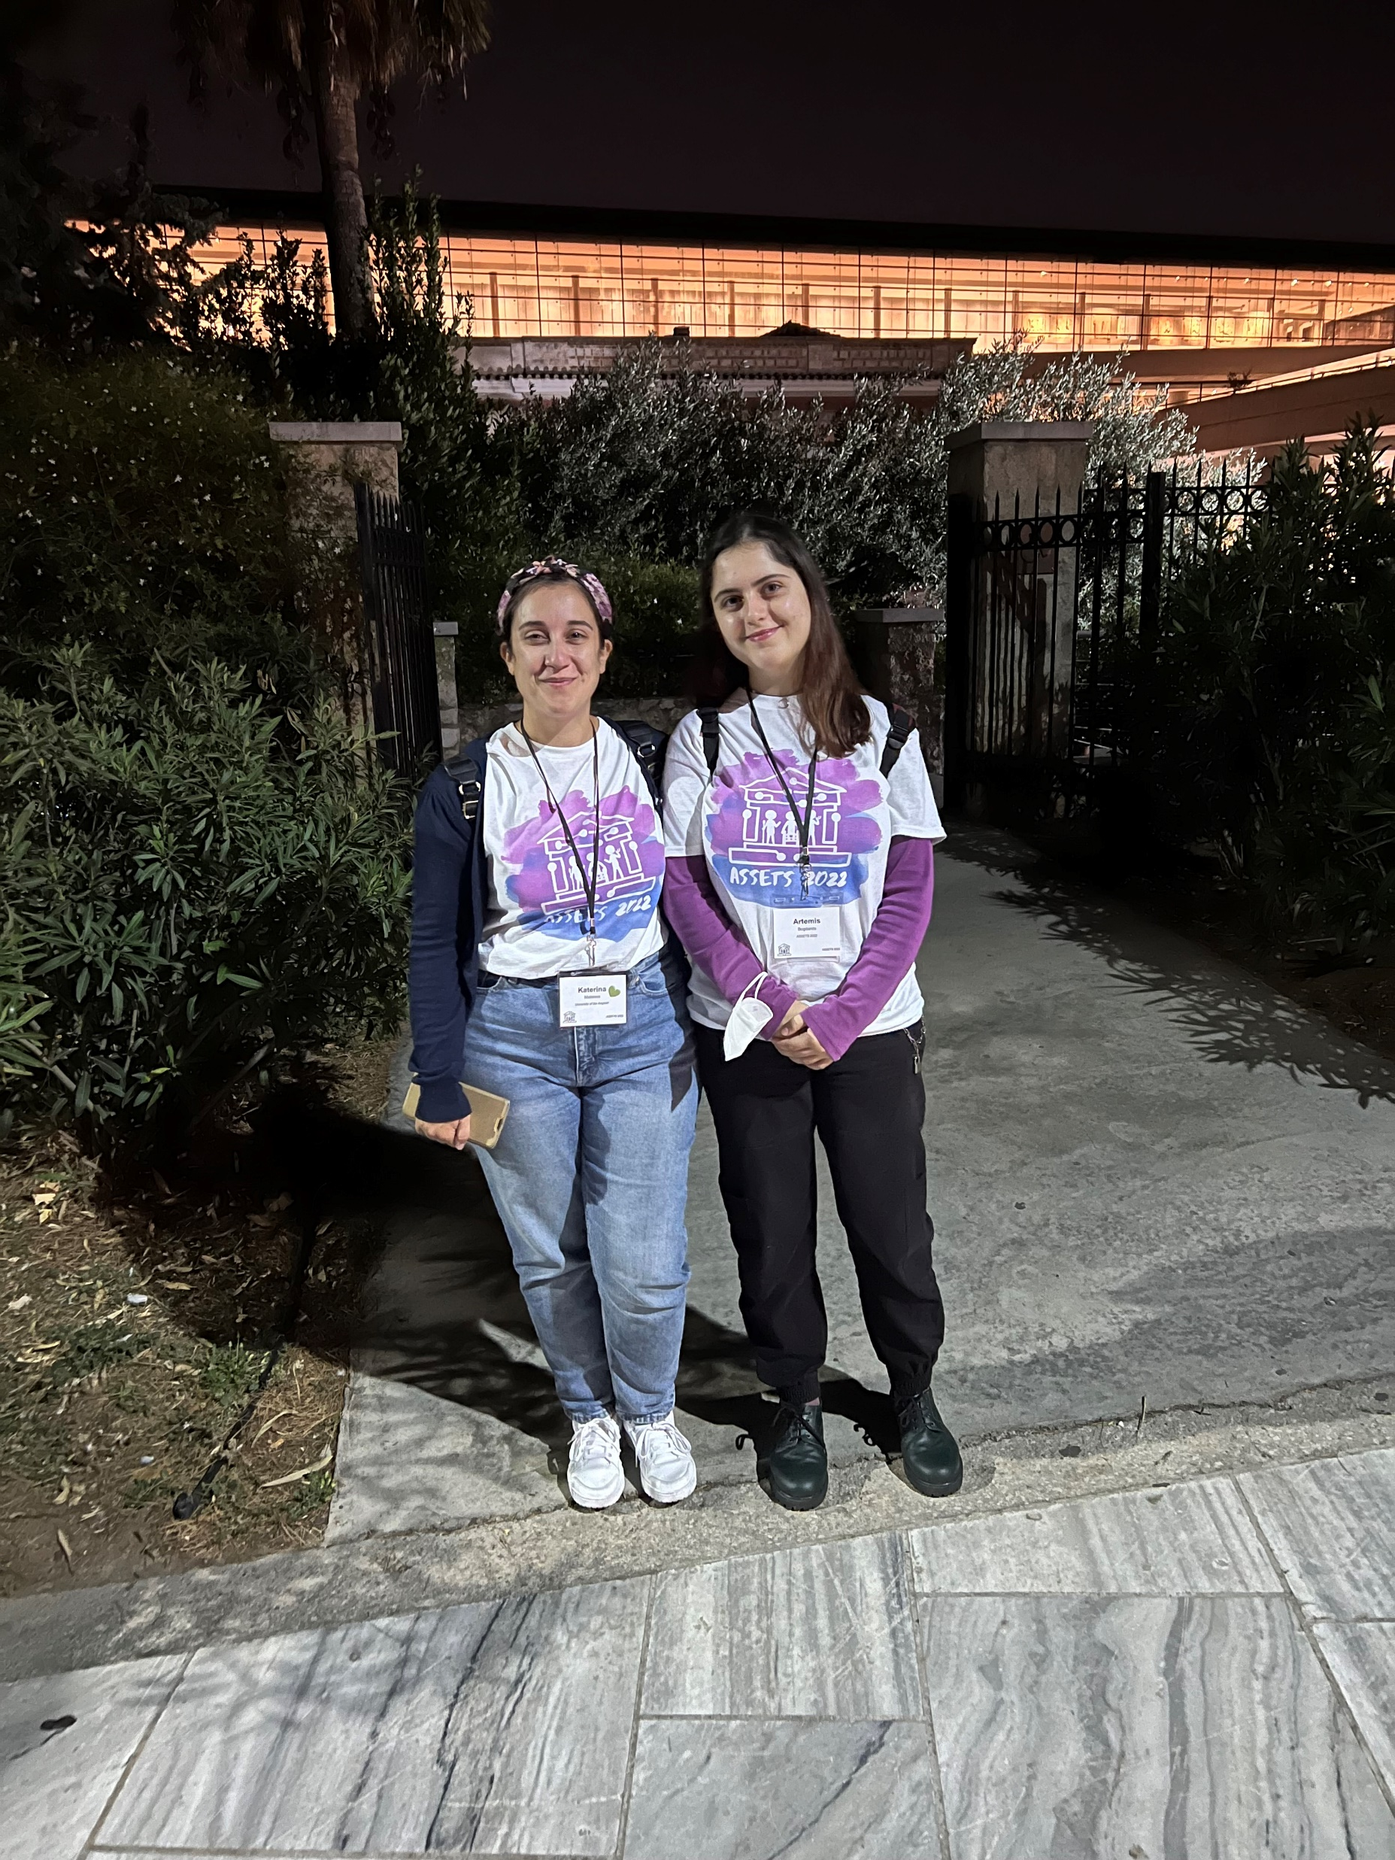
ASSETS’22 SVs at the Acropolis Museum
Notes:
Here are two amazing SVs Katerina and Artemis showing off the t-shirts at the Acropolis Museum and Cafe

Slide 32
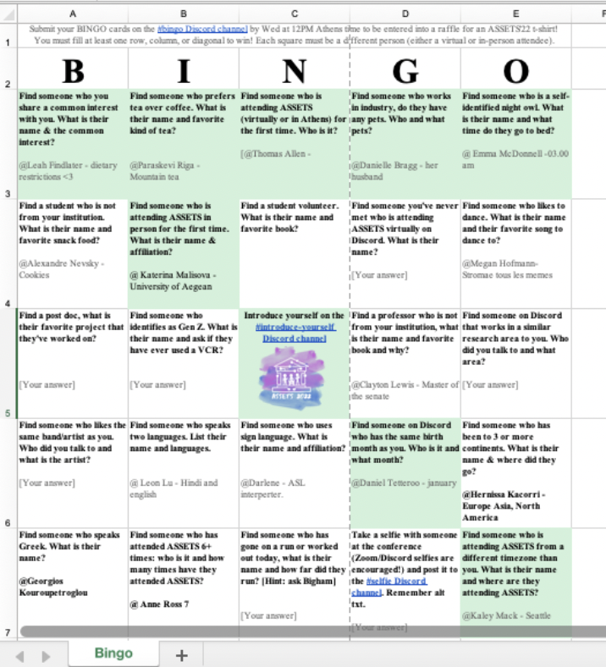




ASSETS’22 Bingo Cards

Slide 33
Leandro Soares Guedes
ASSETS’22 Bingo Winner
Notes:
Leandro is a Research Assistant and Ph.D. Student at USI

Slide 34
Jaisie Sin
ASSETS’22 Bingo Winner
Notes:
PhD student at University of Toronto

Slide 35
Best Artifact Awards
Notes:
We have a similarly exciting program for Day 2

Slide 36

Best Artifact Award Candidates
Notes:
We’re happy to once again have a Best Artifact Award. Please vote for your choice of Best Artifact through the link on the conference web page
----
publicly available apps, data sets, commercial products, or open-source projects on the conference web page.
The Top-3 Best Artifacts will be selected based on the project’s contribution to the field of accessibility. A combination of delegate voting and input from a panel of judges will determine the winners.

Slide 37





Best Artifact Award Committee
ASSETS’22
Chair
Panel Judges
Dragan Ahmetovic
Università degli Studi di Milano
Jeffrey P. Bigham CMU HCII & Apple
Tiago Guerreiro Universidade de Lisboa
Jinjuan Heidi Feng Towson University
Victoria Yaneva NBME & University of Wolverhampton

Slide 38

Best Artifact Award: 3rd Place
ASSETS’22
UnlockedMaps: Visualizing Real-Time Accessibility of Urban Rail Transit Using a Web-Based Map Ather Sharif, Aneesha Ramesh, Trung-Anh Nguyen, Luna Chen, Kent Richard Zeng, Lanqing Hou, Xuhai Xu
3rd
Notes:
UnlockedMaps: Visualizing Real-Time Accessibility of Urban Rail Transit Using a Web-Based Map Ather Sharif, Aneesha Ramesh, Trung-Anh Nguyen, Luna Chen, Kent Richard Zeng, Lanqing Hou, Xuhai Xu

Slide 39


Best Artifact Awards: Tie for first
ASSETS’22
AAC with Automated Vocabulary from Photographs: Insights from School and Speech-Language Therapy Settings Mauricio Fontana de Vargas, Jiamin Dai, Karyn Moffatt, McGill University
CodeWalk: Facilitating Shared Awareness in Mixed-Ability Collaborative Software Development Venkatesh Potluri¹, Maulishree Pandey¹, Andrew Begel², Michael Barnett², Scott Reitherman² ¹University of Washington, ²Microsoft Research, Redmond
1st
1st

Slide 40
Student research competition
Notes:
We have a similarly exciting program for Day 2

Slide 41






Best Artifact Award Committee
ASSETS’22
Chairs
Judges
Roshan Peiris
RIT
Mingming Fan Hong Kong UST
Xin Tong Duke Kunshan U.
Zikai Alex Wen Hong Kong UST
Suranga Nanayakkara National U. of Singapore

Slide 42
SRC: Undergraduate category
ASSETS’22
Challenges and Opportunities in Creating An Accessible Web Application for Learning Organic Chemistry Allyson Grace Yu, Temple University
1st

Slide 43
SRC: graduate category
ASSETS’22
FootUI: Designing and Detecting Foot Gestures to Assist People with Upper Body Motor Impairments to Use Smartphones on the Bed Hu Xiaozhu, University of Science and Technology Hong Kong, Tsinghua University Jiting Wang, Tsinghua University Weiwei Gao, Tsinghua University Yongquan Hu, University of New South Wales
Investigating Sign Language Interpreter Rendering and Guiding Methods in Virtual Reality 360-Degree Content Craig Anderton, Birmingham City University
2nd
1st

Slide 44
Best Paper Awards
Notes:
We have a similarly exciting program for Day 2

Slide 45





Best Paper Committee
ASSETS’22
Anthony Hornof U. of Oregon
Amy Hurst U. of Oregon
Cynthia Putnam DePaul
Sayan Sarcar Birmingham City U.
Gerhard Weber Technische U. Dresden
Notes:
This year’s best papers were selected by a best paper committee composed of five people and led by Professor Hornof at the University of Oregon

Slide 46
8 Best Paper Nominees: First four
Steven Goodman, University of Washington
Andy Coenen, Google
Aaron Donsbach, Google
Tiffanie Home, Google
Michal Lahav, Google
Robert MacDonald, Google
Rain Breaw Michaels, Google
Agit Narayanan, Google
Mahima Pushkama, Google
Rachel Sweeney, Google
Meredith Ringel Morris, Google
ASSETS’22
1
Quantifying Touch: New Metrics for Characterizing What Happens During a Touch Junhan Kong, Mingyuan Zhong, James Fogarty, Jacob Wobbrock, University of Washington
Accessible Blockly: An Accessible Block-Based Programming Library for People with Visual Impairments Aboubakar Mountapmbeme, Obiamuju Okafor, Stephanie Ludi, University of North Texas
LaMPost: Design and Evaluation of an AI-assisted Email Writing Prototype for Adults w/ Dyslexia Steven Goodman¹, Andy Coenen², Aaron Donsbach², Tiffanie Home², Michael Lahav², Robert MacDonal², Rain Breaw Michaels², Agit Narayanan², Mahima Pushkama², Rachel Sweeney², Meredith Ringel Morris² ¹University of Washington; ²Google
A Collaborative Approach to Support Medication Management in Older Adults with Mild Cognitive Impairment Using Conversational Assistants (CAs) Niharika Mathur¹, Tamara Zubatiy¹, Jiachen Li¹, Brian Jones¹, Elizabeth Mynatt² ¹Georgia Tech; ²Northeastern University
2
3
4
Notes:
The papers are…
(please hold your applause)

Slide 47
8 Best Paper Nominees: Next four
ASSETS’22
5
Blind Users Accessing Their Training Images in Teachable Object Recognizers Jonggi Hong¹, Jaina Gandhi², Ernest Mensah², Famaz Zeraati², Ebrima Jarjue², Kyungiun Lee², Hernisa Kacorri² ¹Smith-Kettlewell Eye Research Institute; ²University of Maryland, College Park
AAC with Automated Vocabulary from Photographs: Insights from School and Speech-Language Therapy Settings Mauricio Fontana de Vargas, Jiamin Dai, Karyn Moffatt, McGill University
Chronically Under-Addressed: Considerations for HCI Accessibility Practice w/Chronically Ill People Kelly Mack, Emma McDonnell, Leah Findlater, Heather Evans, University of Washington
Support in the Moment: Benefits and use of video-span selection and search for sign-language video comprehension among ASL learners Saad Hassan, Akhter Al Amin, Caluã de Lacerda Pataca, Diego Navarro, Alexis Gordon, Sooyeon Lee, Matt Huenerfauth, Rochester Institute of Technology
6
7
8

Slide 48

Best Student Paper
Notes:
Best student paper is:
AAC with Automated Vocabulary from Photographs: Insights from School and Speech-Language Therapy Settings Mauricio Fontana de Vargas, Jiamin Dai, Karyn Moffatt, McGill University

Slide 49
Best Paper
Notes:
Best Paper:
A Collaborative Approach to Support Medication Management in Older Adults with Mild Cognitive Impairment Using Conversational Assistants (CAs) Niharika Mathur¹, Tamara Zubatiy¹, Jiachen Li¹, Brian Jones¹, Elizabeth Mynatt² ¹Georgia Tech; ²Northeastern University

Slide 50
ASSETS’22 Closing Slide
The 24th International ACM SIGACCESS Conference on Computers and Accessibility
Athens, Greece
Oct 23-26

Slide 51
ASSETS’23
Notes:
We have a similarly exciting program for Day 2

Slide 52


